Slide 1

A
Project Report on
E-commerce Platform for Shoes In partial Fulfillment of
Bachelor of Computer Application (B.C.A) Gujarat University (2023-2024)
Gujarat University
Submitted By
Vinit Jumani (2021122100163)
Dhruvil Kadiya (2021122100165)
Navgujarat College of Computer Application
1

Slide 2
Acknowledgement
We would like to express our special thanks of gratitude to our project guide Prof. Ankita Gondaliya as well as our vice-principal incharge, Who gave us the golden opportunity to do this wonderful project on the topic E-commerce platform for shoes, Which also helped us in doing a lotof research and We came to know about so many new things We are really thankful to them.
Secondly, We should also like to thank our parents and friends who helped us a lot in finalizing this project within the limited time frame.
Date: 25/11/2023 | Students Name: Vinit Jumani Dhruvil Kadiya
Place: Ahmedabad | BCA(6th Sem)
Navgujarat College of Computer Application
2

Slide 3
INDEX
S.NO | TITLE | P.NO
1. | COMPANY PROFILE | 2
2. | PROJECT PROFILE | 4
3. | HARDWARE AND SOFTWARE REQUIREMENTS | 5
4. | HARDWARE AND SOFTWARE REQUIREMENTS | 7
5. | ADMIN SIDE SCREEN SHOTS | 8
6. | USER SIDE SCREEN SHOTS | 18
7. | VENDOR SIDE SCREEN SHOTS | 36
8. | REPORT LAYOUT | 47
9. | SAMPLE CODING | 52
10. | FUTURE ENHANCEMENTS | 55
11. | CONCLUSION | 56
12. | BIBLIOGRAPHY | 57
13. | LOG SHEET OF REPORTING | 58
Navgujarat College of Computer Application
2

Slide 4
NAVGUJARAT COLLEGE OF COMPUTER APPLICATION
1

Slide 5

COMPANY PROFILE
Company Name | INFOLABZ IT SERVICES PVT. LTD.
Director Name | Mr. Chintan Nagrecha
Contact No. | 8866662662
Email Id | info@infolabz.in
Address | Vraj Avenue, 405, above SAM'S Pizza, nr. Commerce Six Road, Navrangpura, Ahmedabad, Gujarat 380009
Website | www.infolabz.in

Slide 6
Established in 2011, we are a distinguished entity within the IT industry, operating as a subsidiary of a prominent parent IT corporation. Our enduring presence in the market attests to our solid reputation and unwavering commitment to excellence.
Our core strength lies in our highly qualified and experienced team, meticulously prepared to confront and conquer any challenges that may arise.
Our dedicated team comprises seasoned experts proficient in a wide array of cutting-
edge technologies. Additionally, we maintain specialized teams for UI/UX and graphic design. Our clientele spans the globe, with hundreds of satisfied clients benefiting from our comprehensive services.
In this segment, we maintain dedicated teams specifically tasked with API and web service management, as well as crafting contemporary material designs. Our unyielding dedication to innovation is evident in every app we create, as we continually seek to expand our horizons and knowledge with each project.
InfoLabz proudly offers industry-oriented live project training, catering to students pursuing CE/IT (BE/B.TECH & DIPLOMA ENGINEERING), BCA/MCA, BSc
IT/MSc IT degrees. Our training programs provide students with invaluable hands-on
experience, bridging the divide between theoretical knowledge and real-world application. This immersive experience empowers students to gain a deeper understanding of engineering principles and apply their acquired skills to develop practical software and live websites.

Slide 7
PROJECT PROFILE :-
Project Title
: - E-COMMERCE PLATFORM FOR SHOES
: - Prof. Ankita Gondaliya
Internal guide
External guide : - Ms. Twinkle Shah
Project Duration : - 1-Year
Developed In : - Python Django
Group No : - 43
Group Members : - KADIYA DHRUVIL UMESHKUMAR (5026)
JUMANI VINIT HARESHKUMAR (5116)
Presented TO : -
Navgujarat College Of Computer Application Ashram Road, Ahmedabad.

Slide 8
TECHNOLOGIES
The project is developed using technologies mentioned below
FRONTEND
HTML
Hypertext Markup Language (HTML) is the standard Markup language for creating web pages and web applications. With Cascading Style Sheets (CSS) and JavaScript. It forms a triad of cornerstone technologies for the World Wide Web browsers receive HTML documents from a web server or from local storage and render them into multimedia web pages.HTML describes the structure of web Page semantically and originally included cues for the appearance of the document.
CSS
CSS is the language for describing the presentation of web pages, including colours, layout and fonts. It allows one to adapt the presentation to different types of devices, such as large screens, small screens, or printers. CSS is independent of HTML and can be used with any XML-based mark-up language.
JAVASCRIPT
JavaScript is a client-side scripting language developed by Brendan Each JavaScript can be run on any operating systems and almost all web browsers. The programs in this language are called scripts. They can be written right in a web page’s HTML and run automatically as the page loads. Scripts are provided and executed as plain text. They don’t need special preparation or compilation to run. In this aspect, JavaScript is very different from another language called Java.

Slide 9
BACKEND
PYTHON WITH DJANGO FRAMEWORK
Python is a high-level, general-purpose programming language. Its design philosophy emphasizes code readability with the use of significant indentation. Python is dynamically typed and garbage- collected. It supports multiple programming paradigms, including structured, object-oriented and functional programming.
BACKEND
o SQLite : SQLite is one of the most popular and easy-to-use relational database systems. It possesses many features over other relational databases.

Slide 10
HARDWARE AND SOFTWARE REQUIREMENTS
Hardware
Desktop/laptop: windows 8 or above
Storage: 512GB SSD/HDD
Processor: i3 or above
Software
Python - 3.11
Pycharm -IDE
Web Browser
Db Browser

Slide 11
Admin Layout

Slide 12
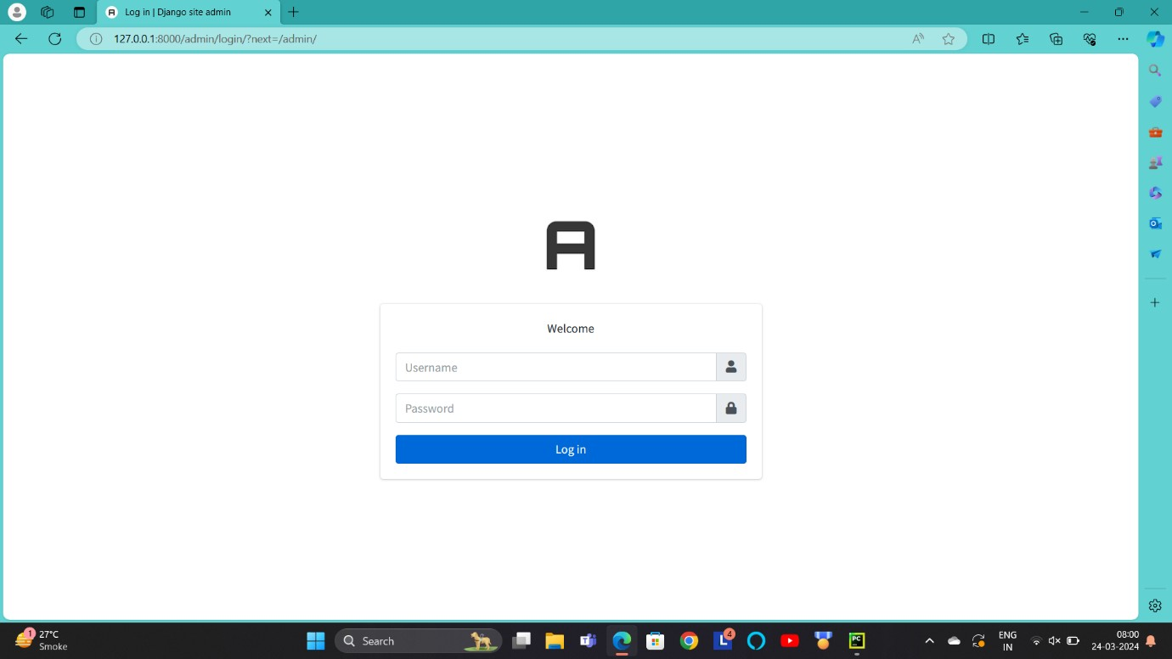
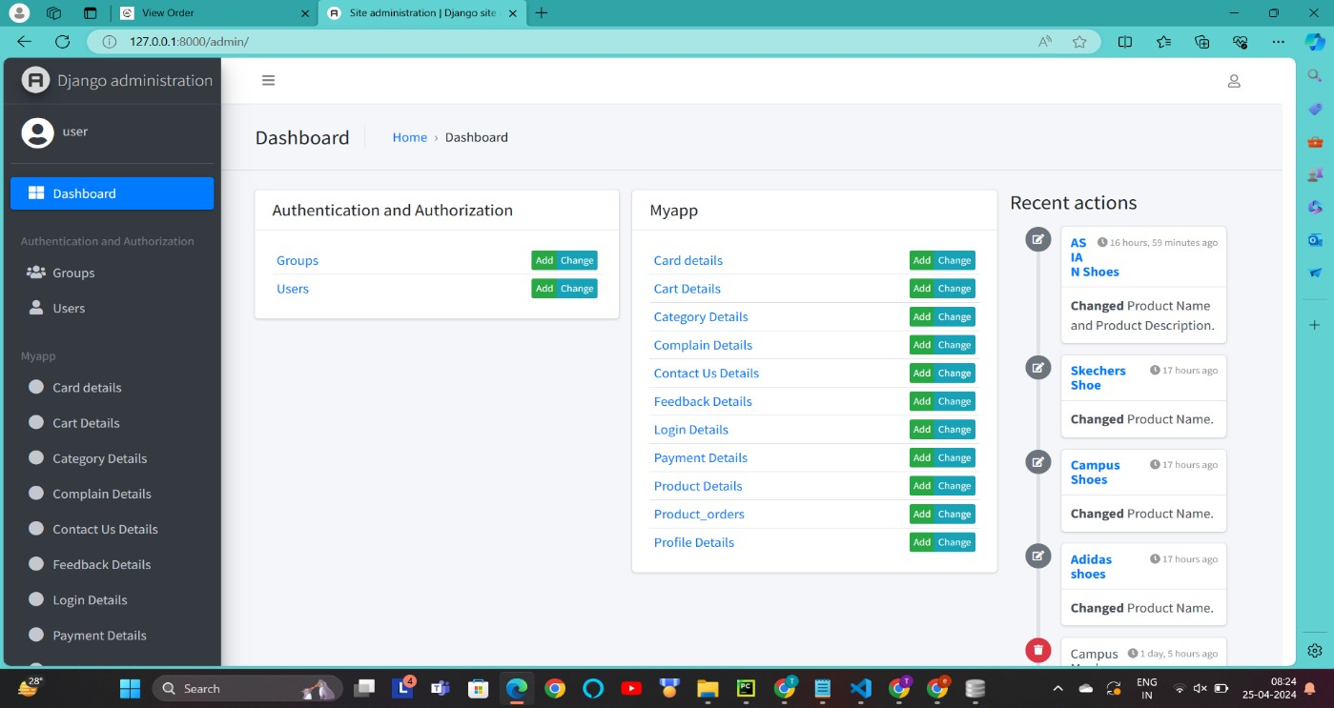
Admin Login Page:-
Description :- This screen-shot is about admin login. Admin can login from here and manage all the things from here (only use for admin).
Dashboard :-
Description :- This screen-shot is about admin dashboard page. In this page admin can access all the functions and manage admin and users.

Slide 13
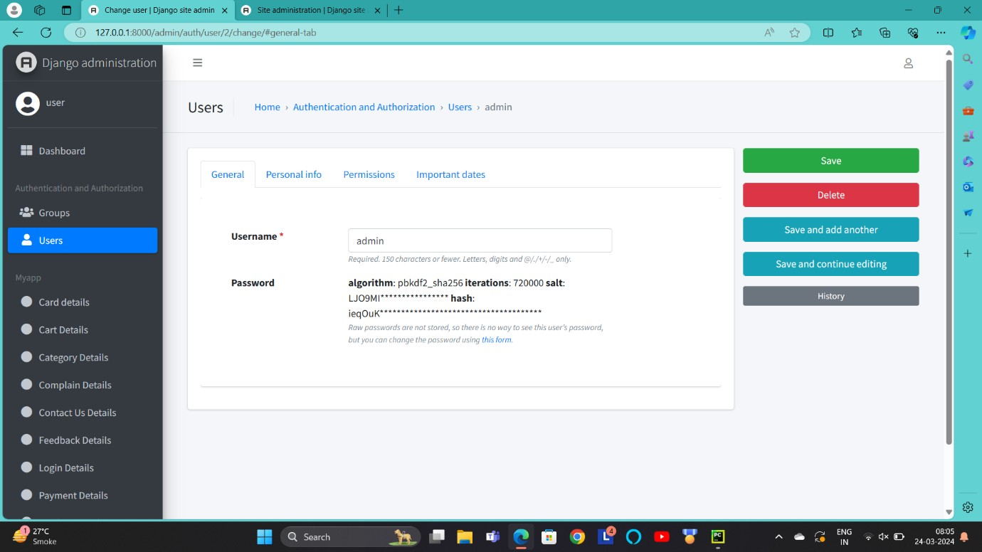
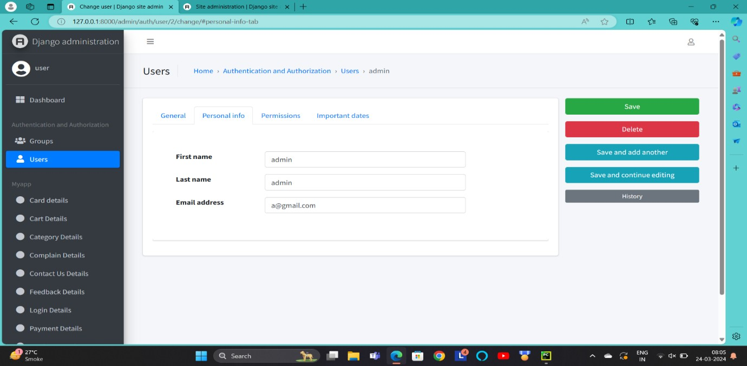
Admin Page :-
General :
Description :- This screen-shot is about admin general page. There is a detail about admin name and password.
Personal information :
Description :- This screen-shot is about admin personal information. In this page there is a personal details of admin like first name, last name and email address.

Slide 14
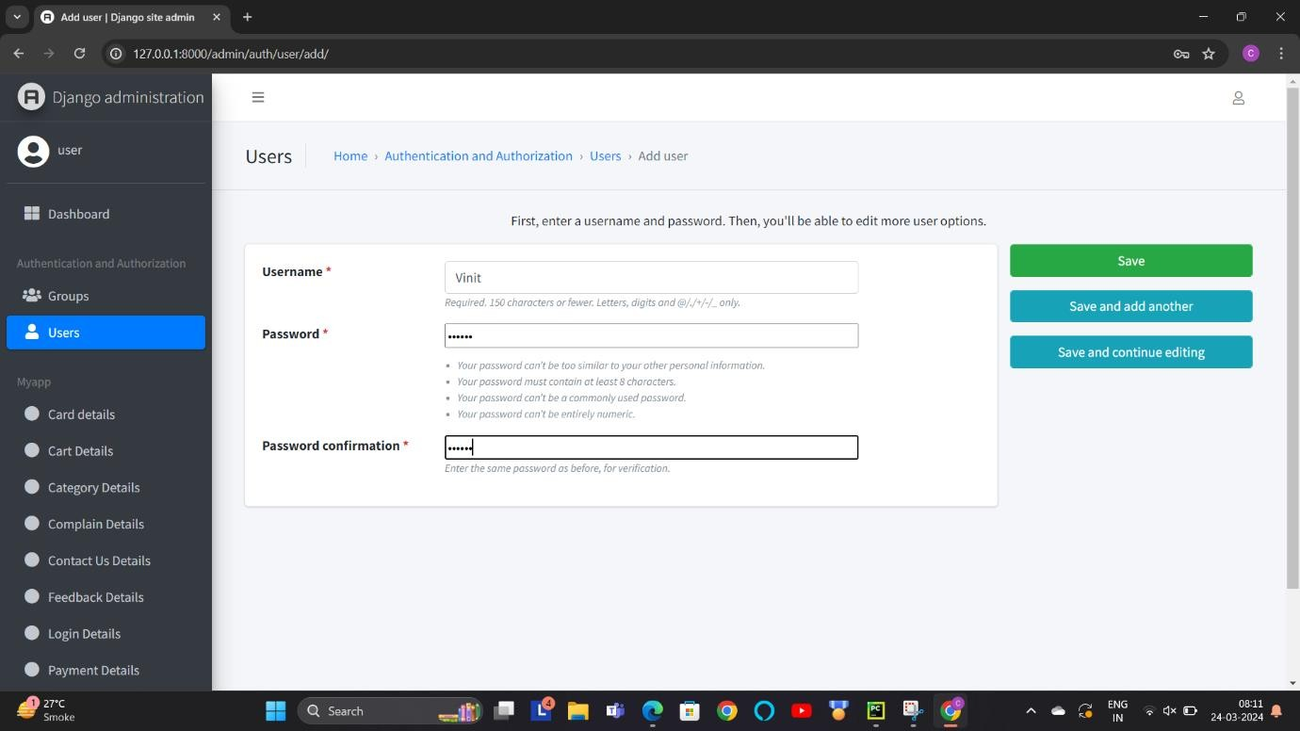
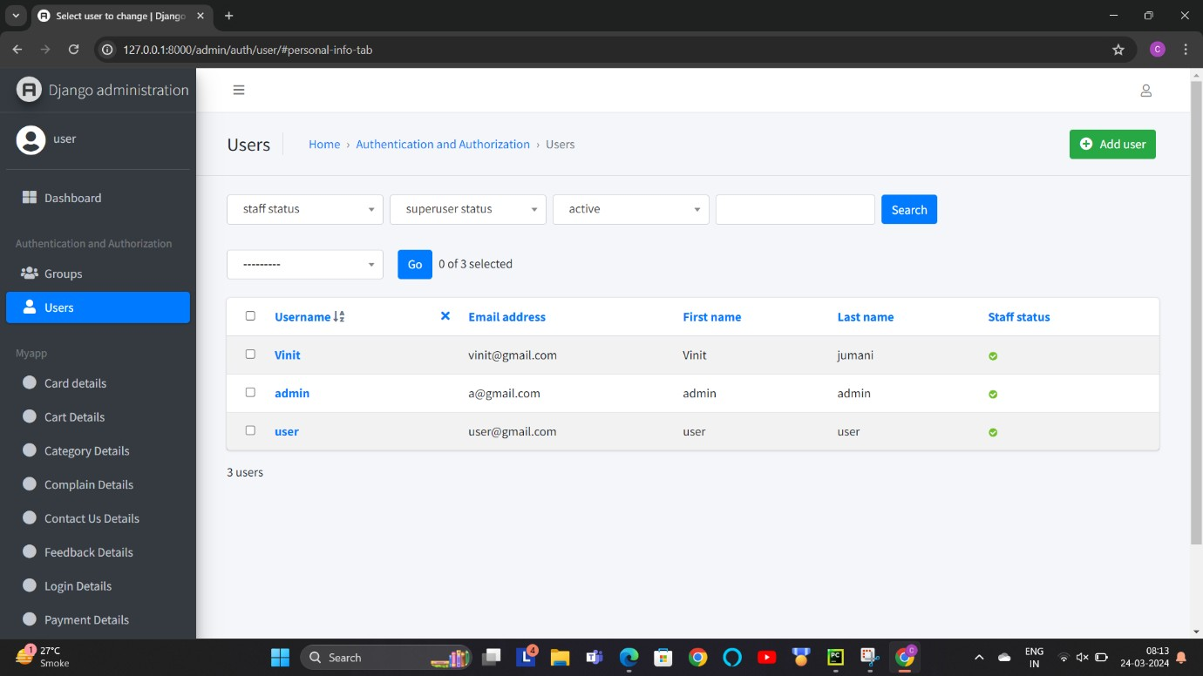
Add Admin :-
Description :- This screen-shot is about add admin page. With the use of this page admin can add another admin and manage this page.

Slide 15
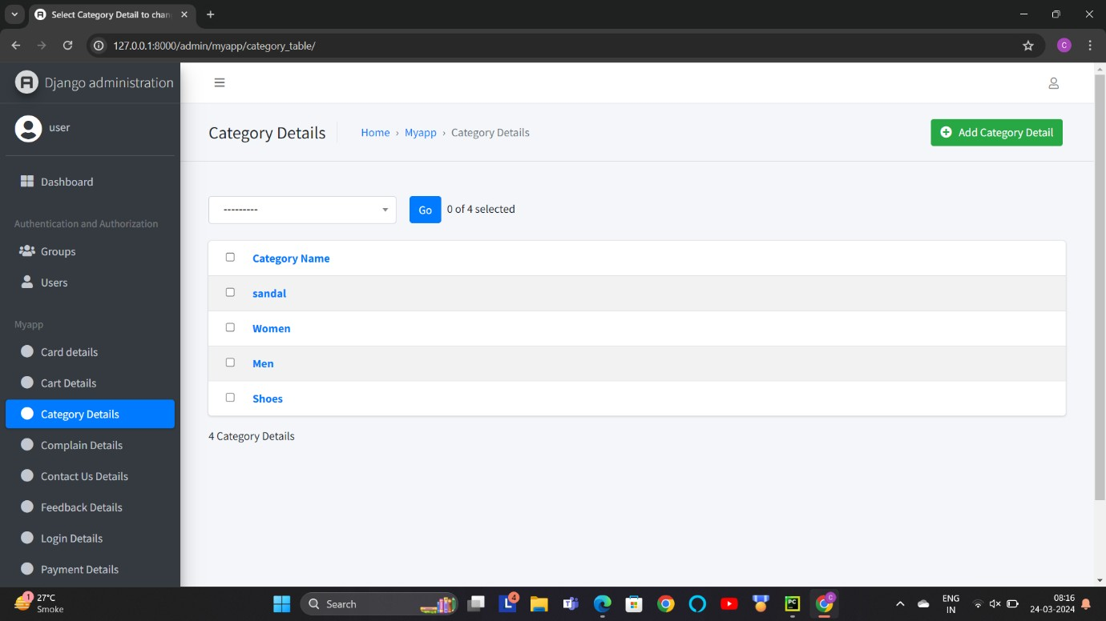
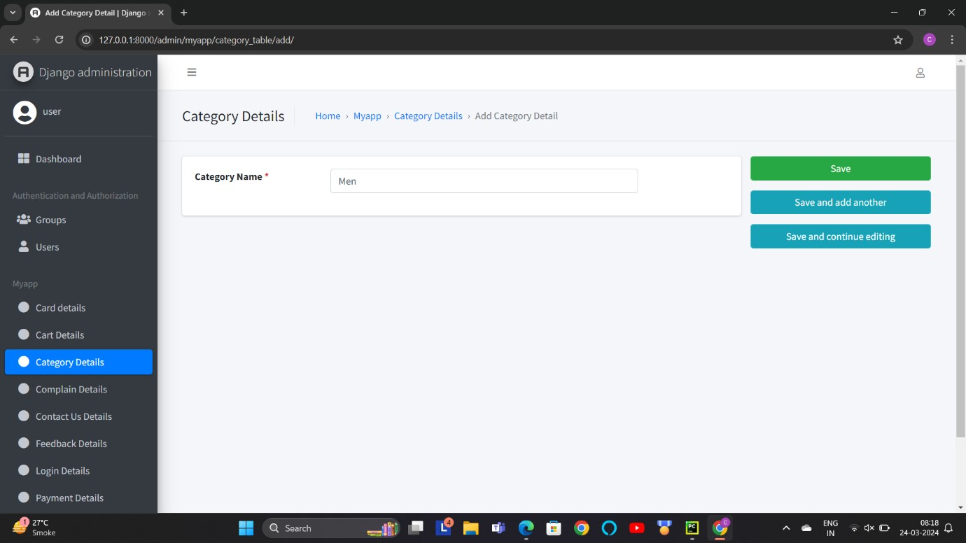
Manage Product Category :-
Description :- This screen-shot is about manage product category. In this page admin can add product and manage it.
Add Product Category :-
Description :- This screen-shot is about add product category. That means admin can add product from this page.

Slide 16
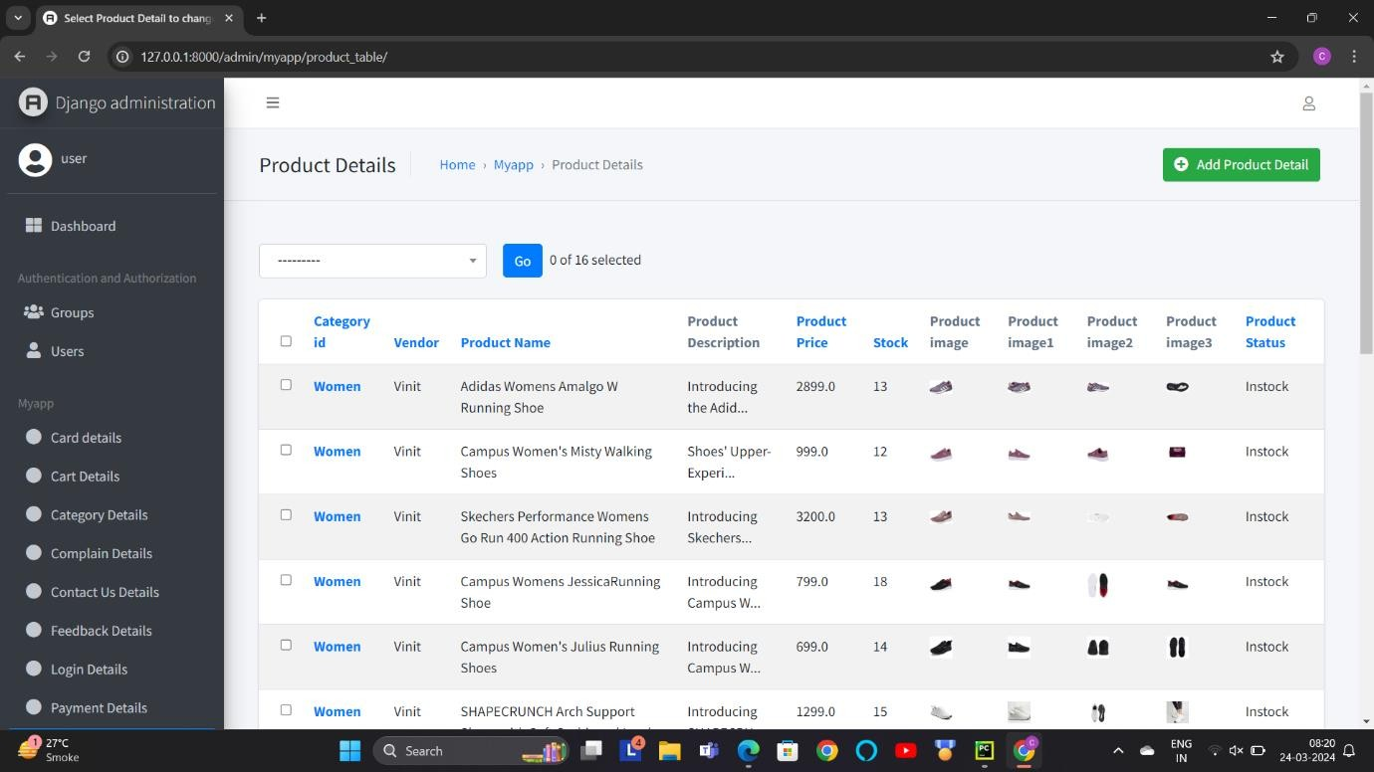
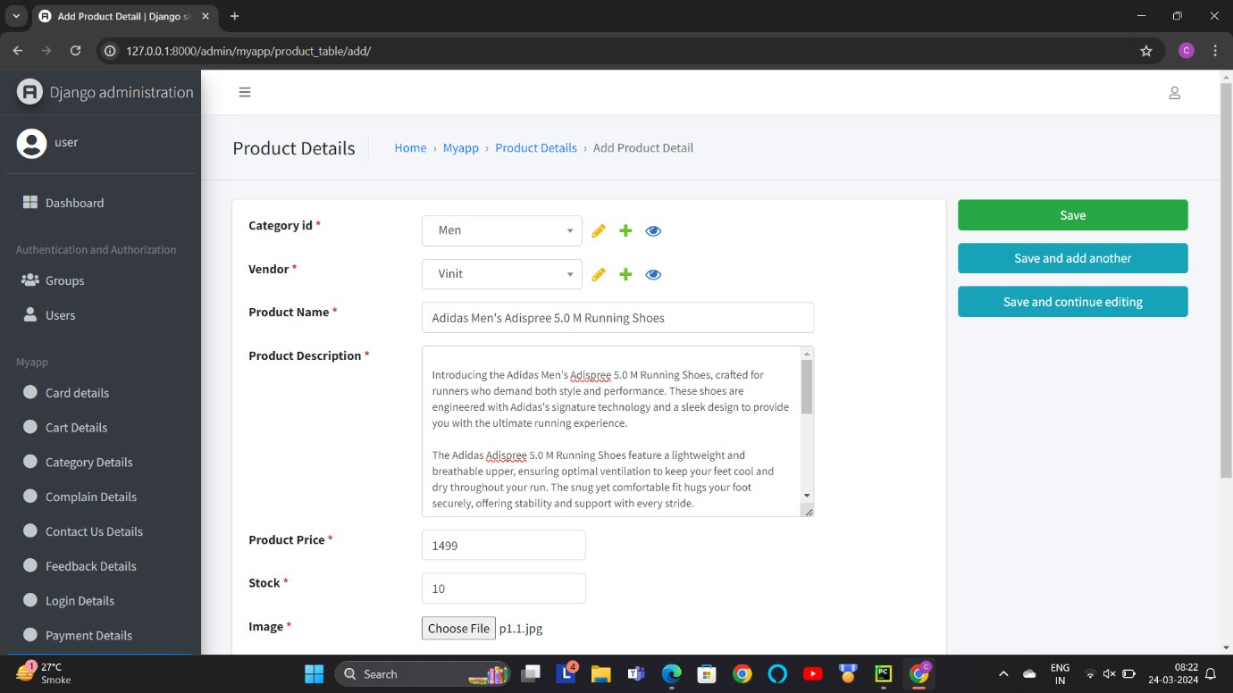
Manage Product Details :-
Description:-This screen-shot is about manage product details. In this page admin can manage the details of every product.
Add Product :

Slide 17
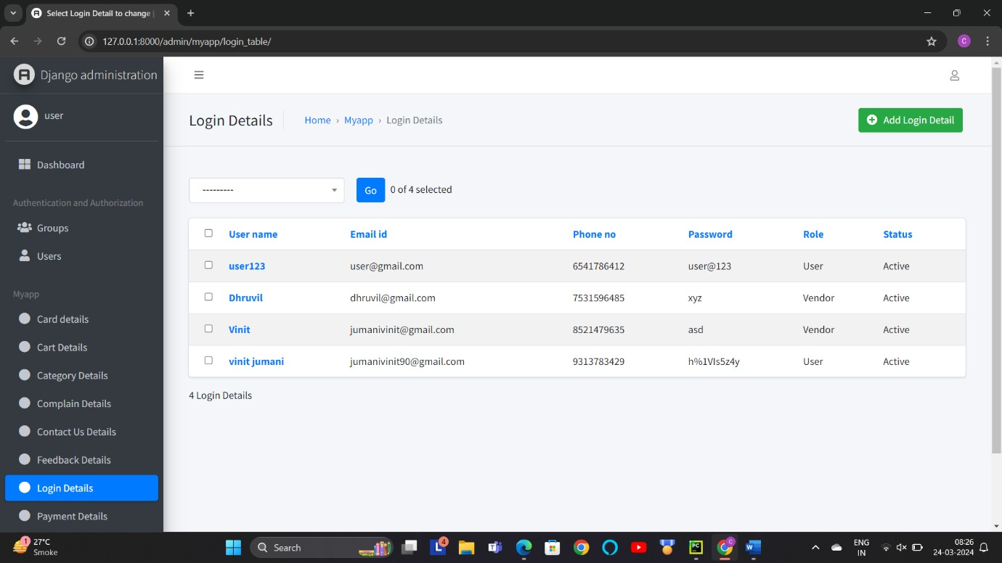
User Login details :-
Description :- This screen-shot is about add product page. Admin can add the new product from here and manage all the products.
Description :- This screen-shot is about user/customer details page. Admin can see all the details from this page and manage all the users and customers from here.

Slide 18
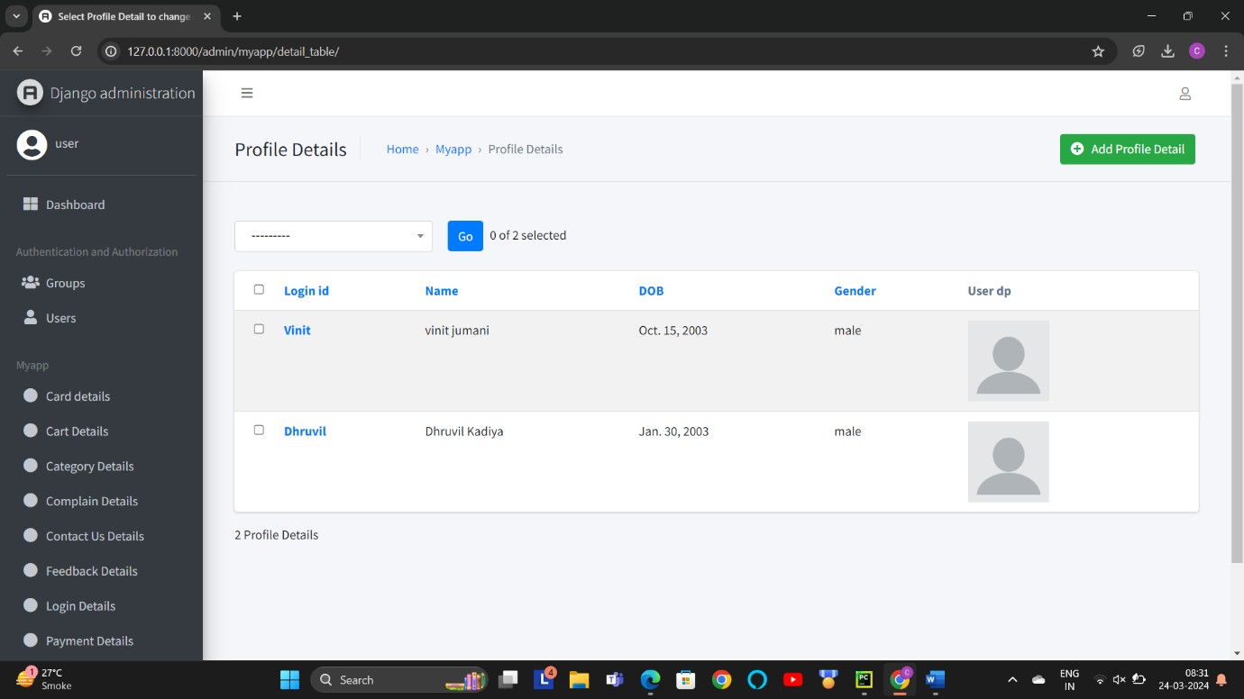
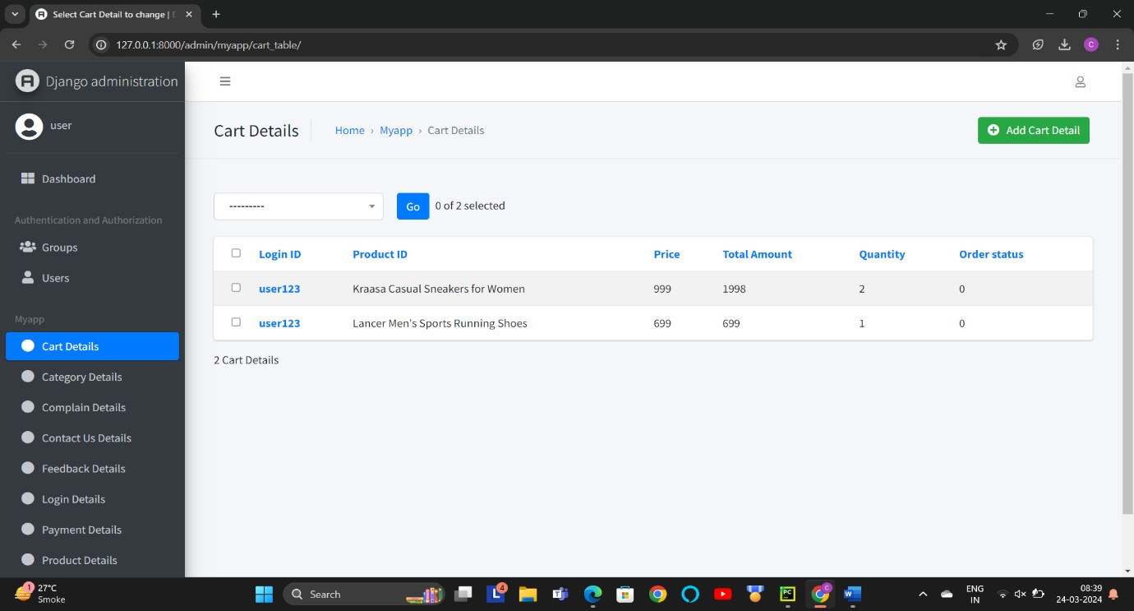
User / Customer Details :-
Description :- This screen-shot is about manage user/customer details page. Admin can see all the details from this page and manage all the users and customers from here.
Manage Product Cart :-
Description :- This screen-shot is about manage product cart. Admin can manage product cart from this page.

Slide 19
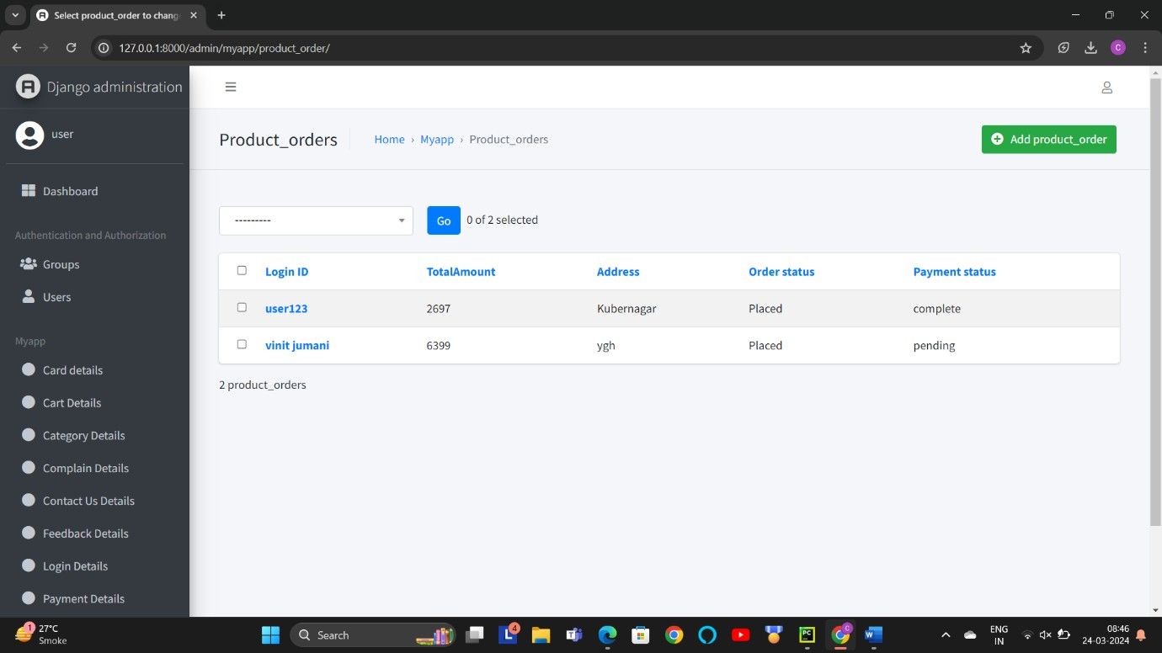

Manage Product Orders :-
Description :- This screen-shot is about manage product orders. Admin can manage product orders from this page.
Manage Card Detail :-
Description :- This screen-shot is about manage card details. In this page there is all the details of user card.

Slide 20
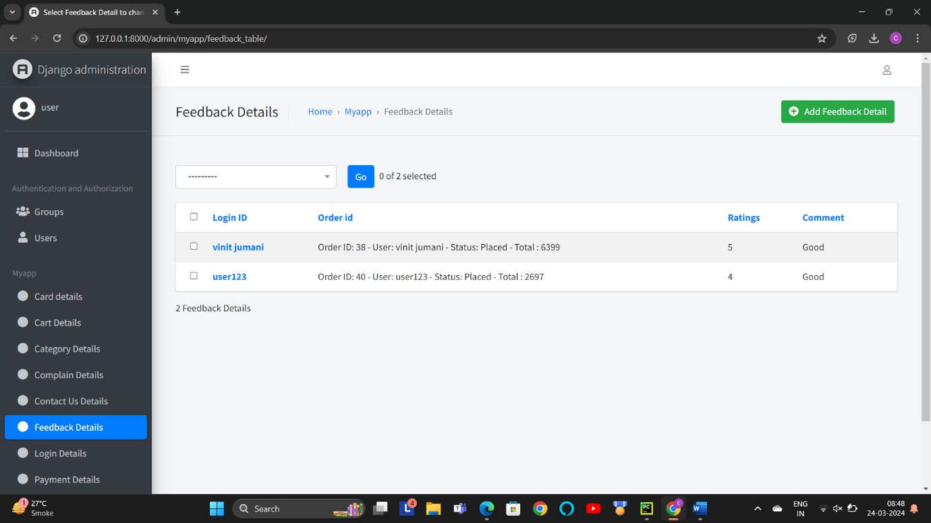
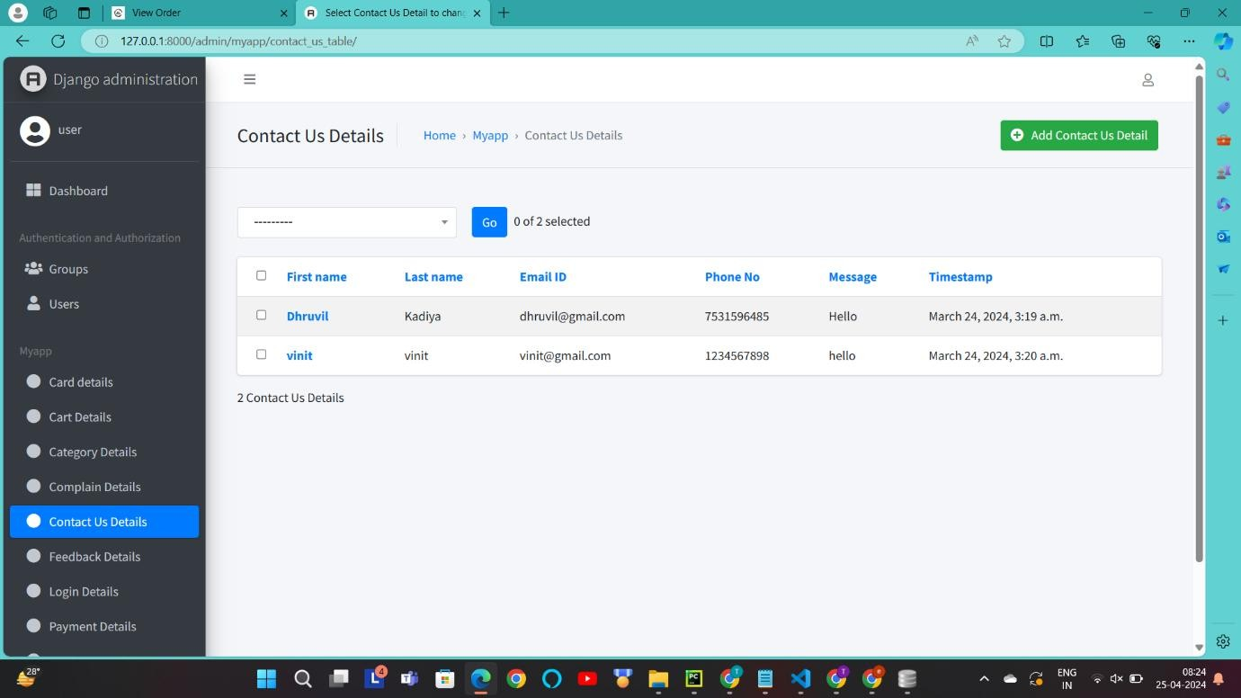
View Feedback :-
Description :-This screen-shot is about feedback table. Users can give feedback and admin can manage this feedbacks and also can delete feedbacks.
View Contact Us :-

Slide 21
USER LAYOUT

Slide 22
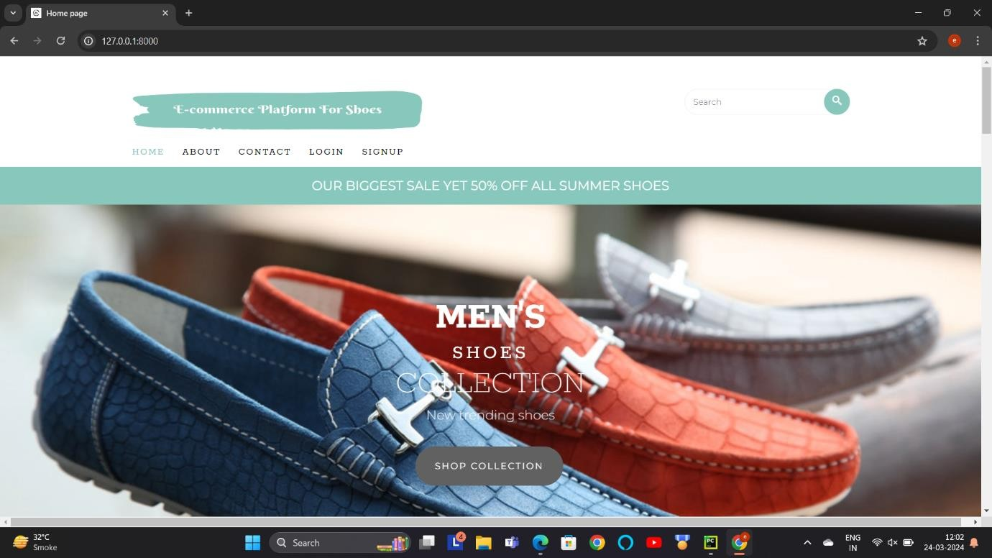
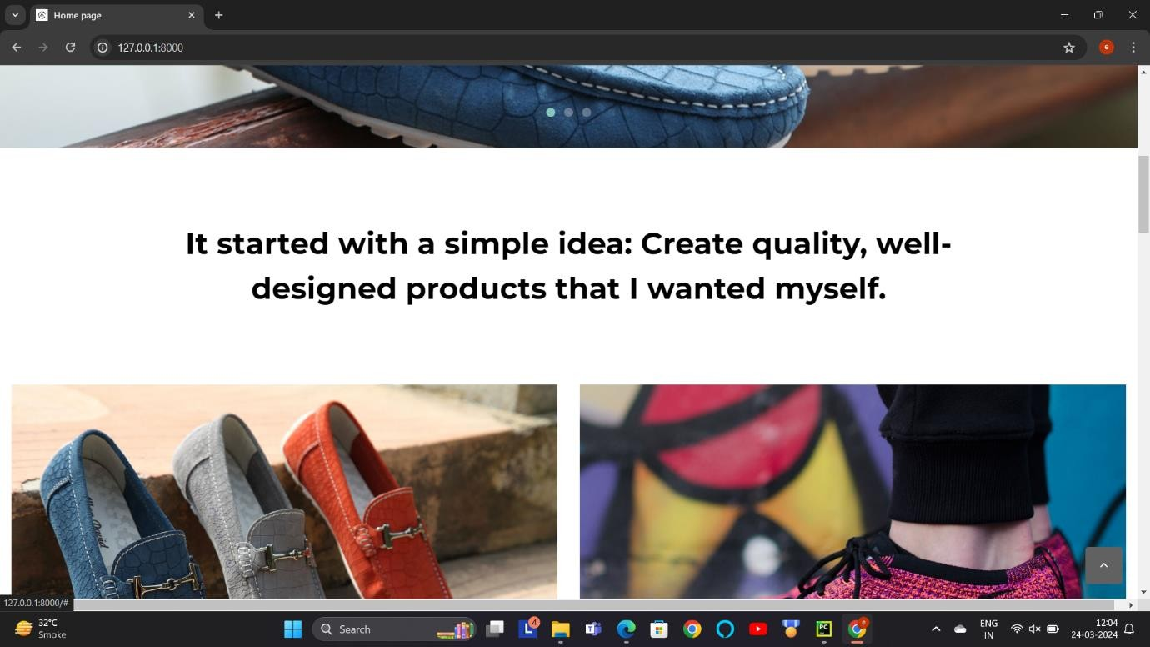
Home Page :-

Slide 23
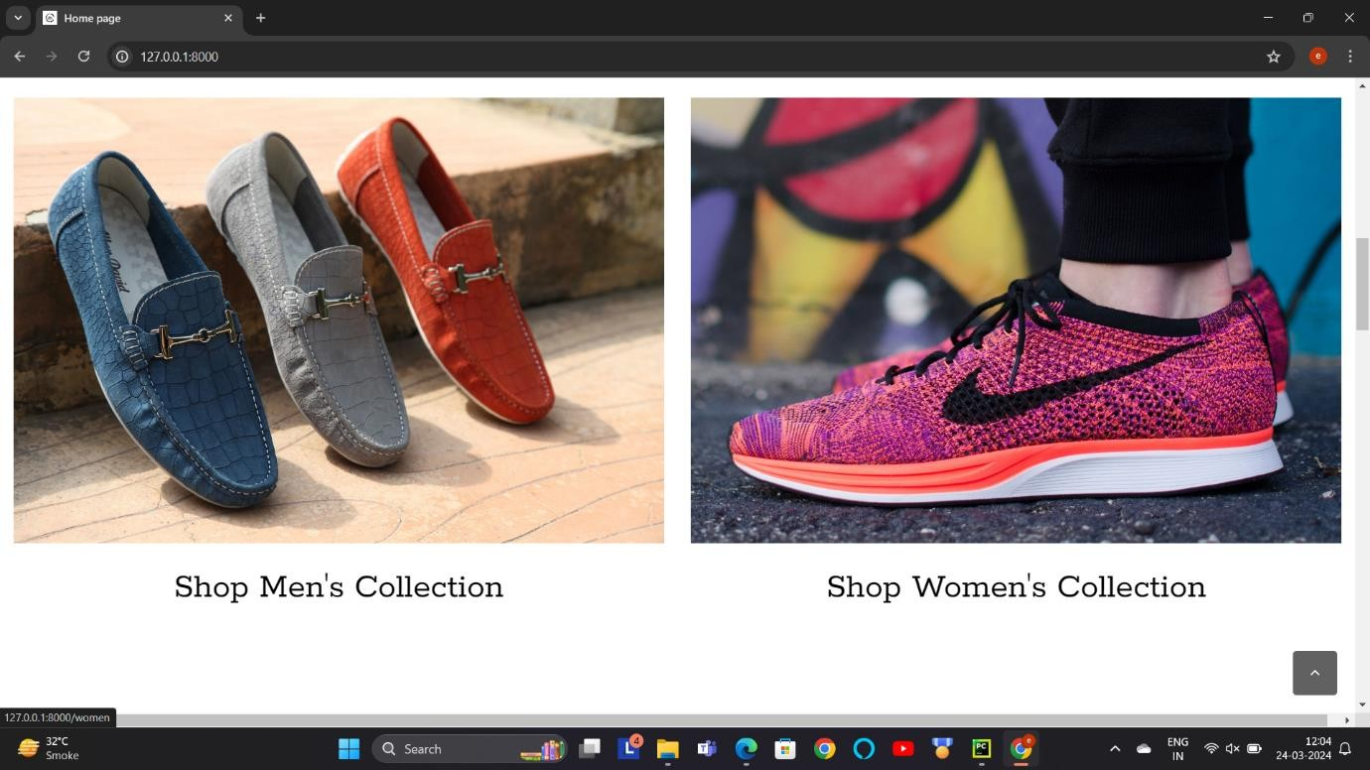
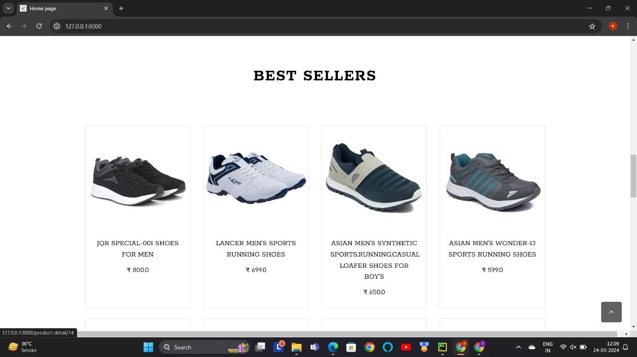

Slide 24
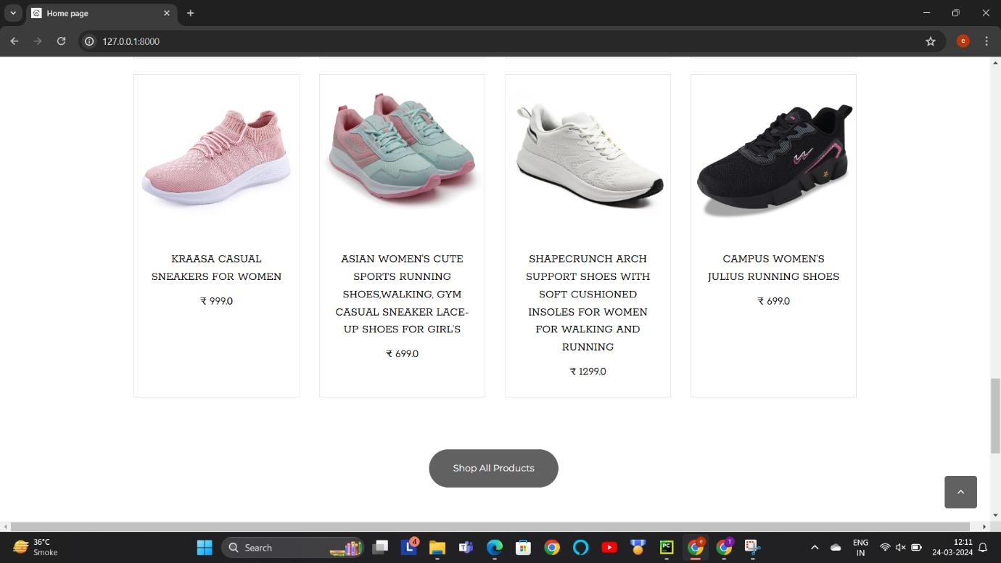
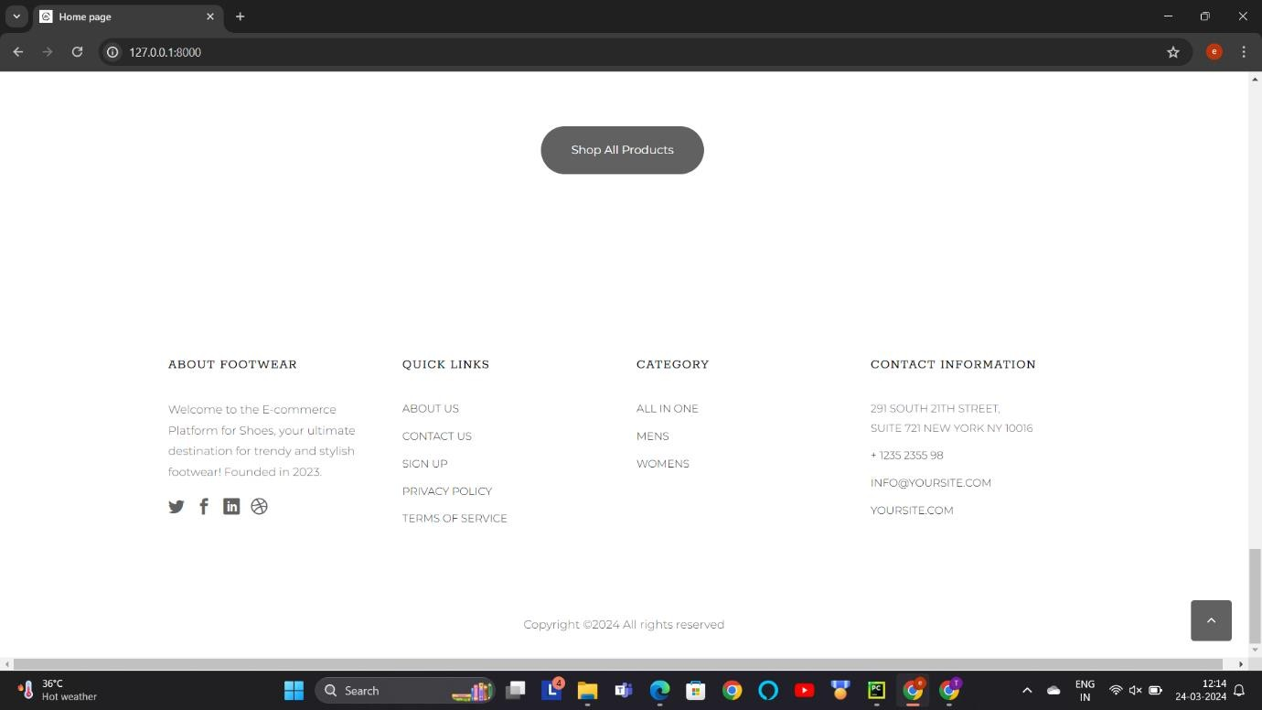
Description :-This screen-shots are about home page. In this users can visit this website and check the products and if they want to purchase then they can purchase ant product according to their
choices.

Slide 25
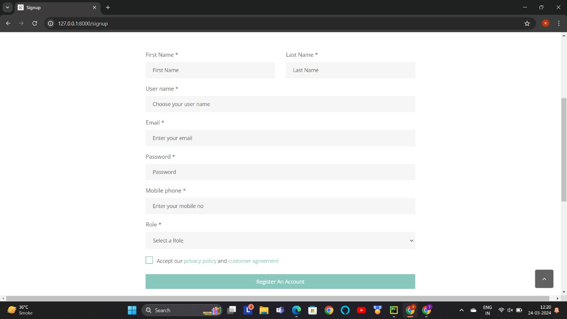
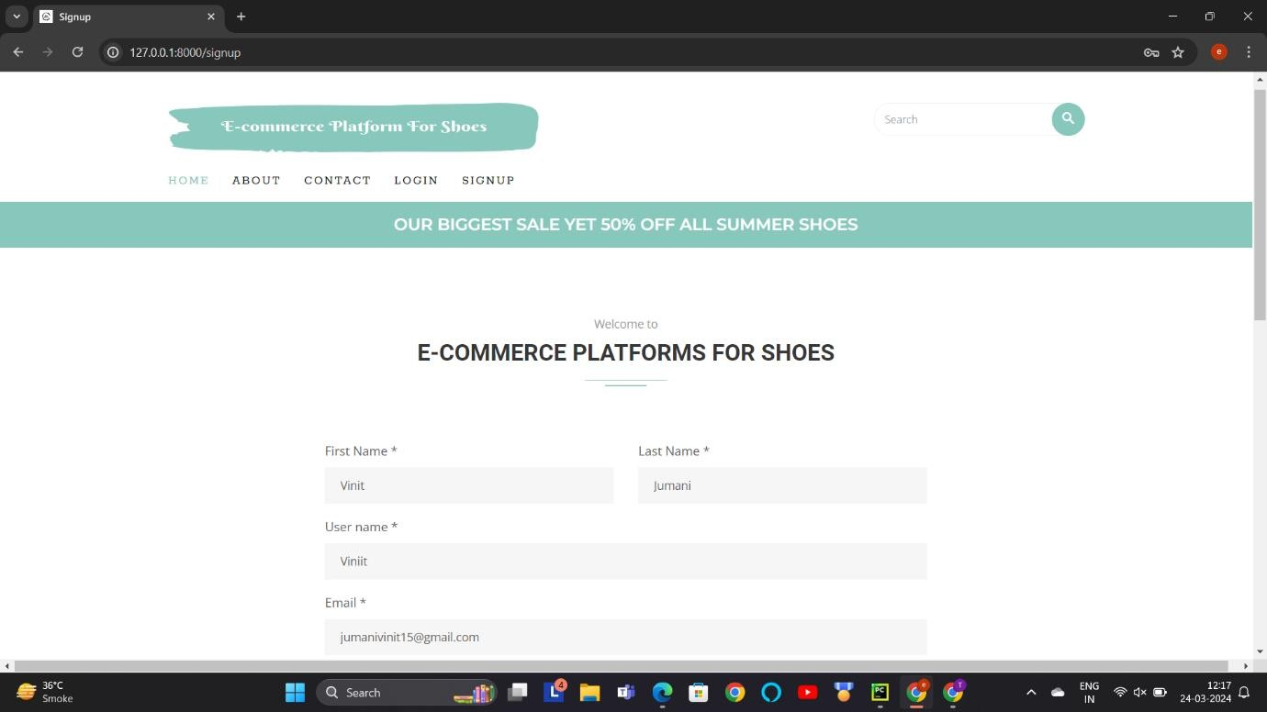
Registration Page:-

Slide 26
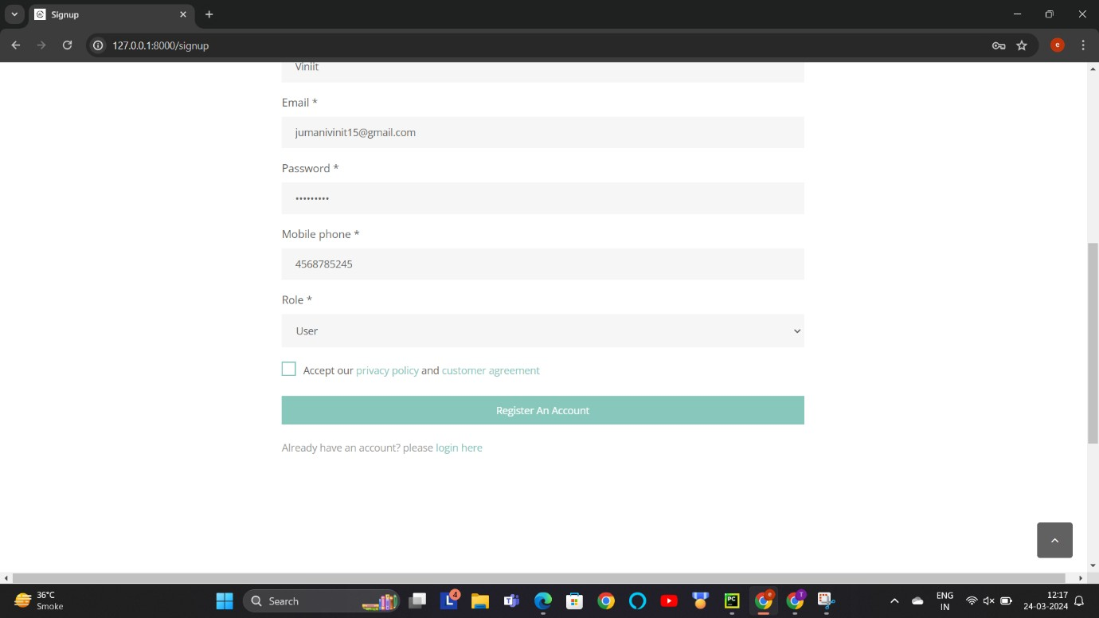
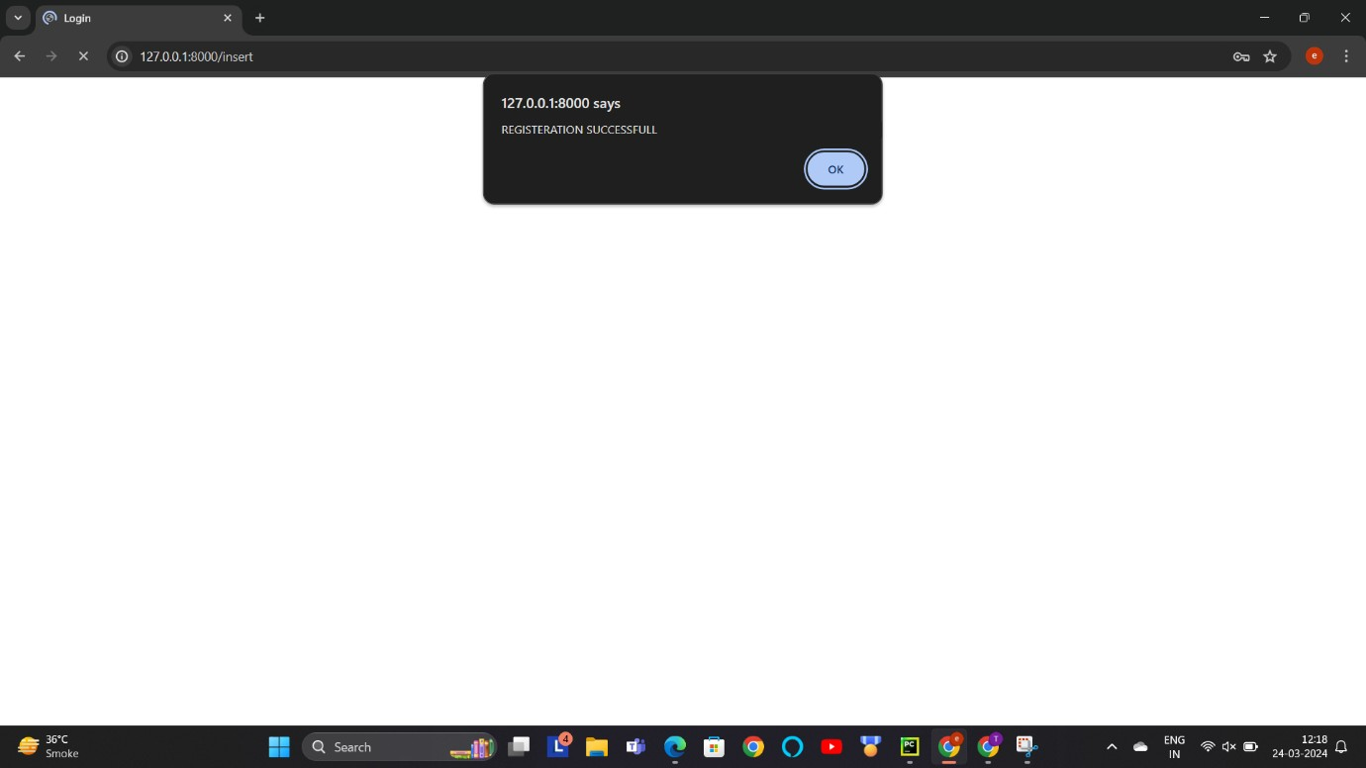
Description :- This screen-shot is about registration page. User can register their self for purchasing any product.
Description :- This screen-shot show when user is successfully registered. After registering users have to login.

Slide 27
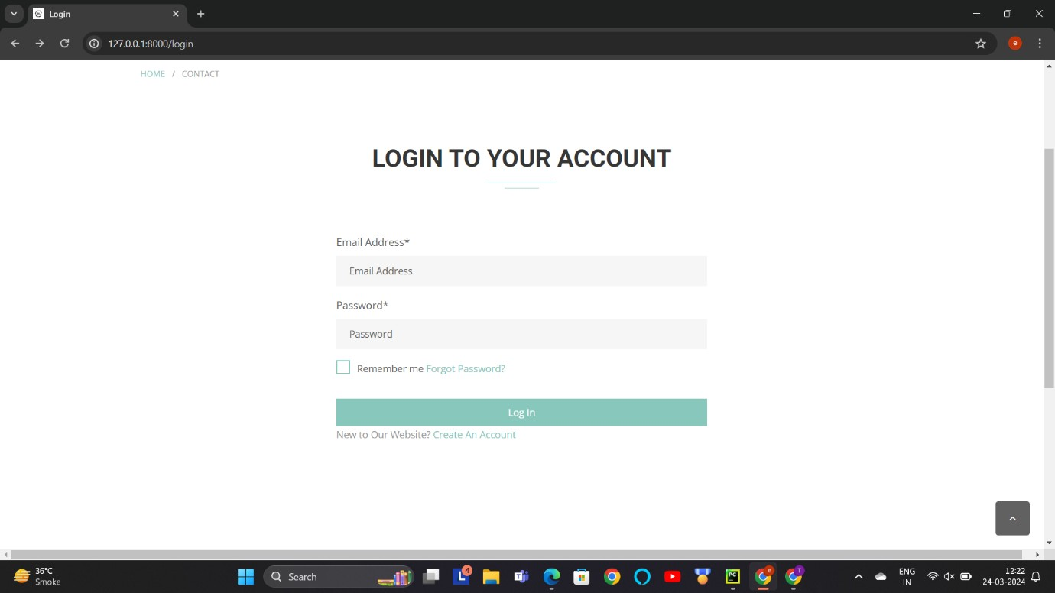
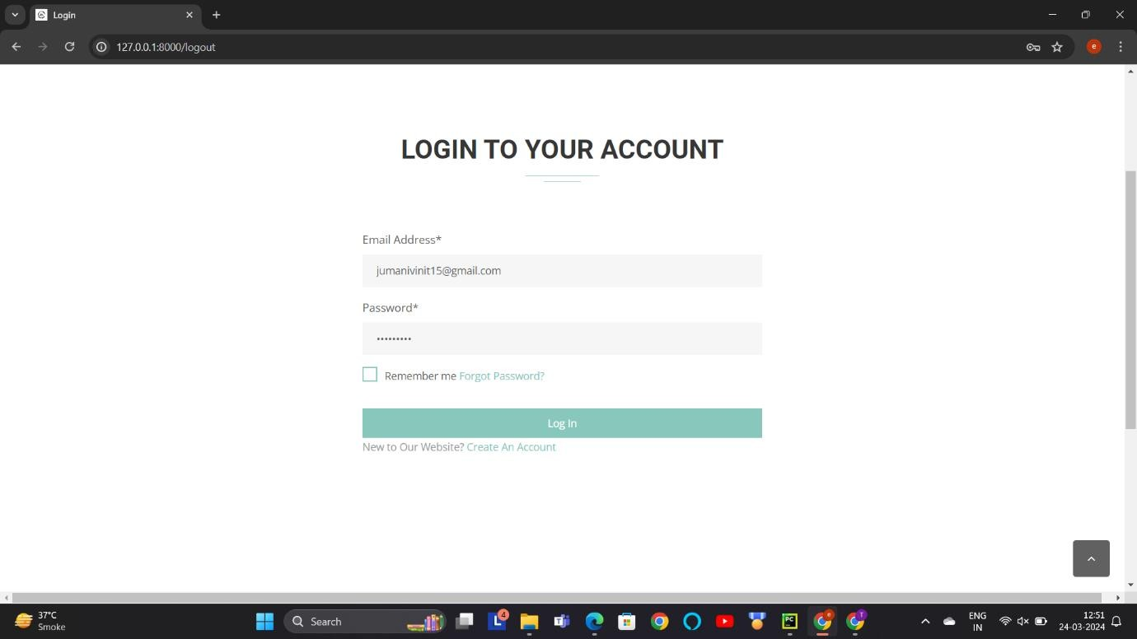
Login Page :-
Description :- This screen-shot is about login page. User can login from here with their email id and password.

Slide 28
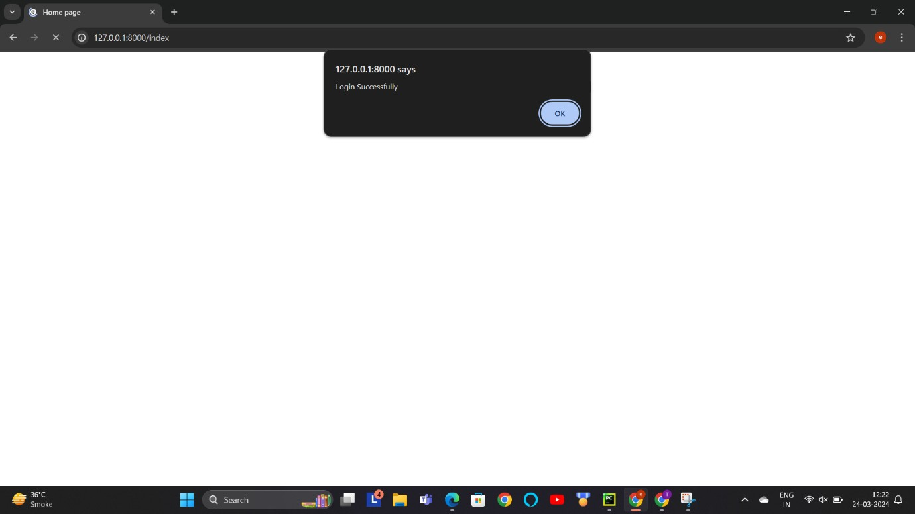
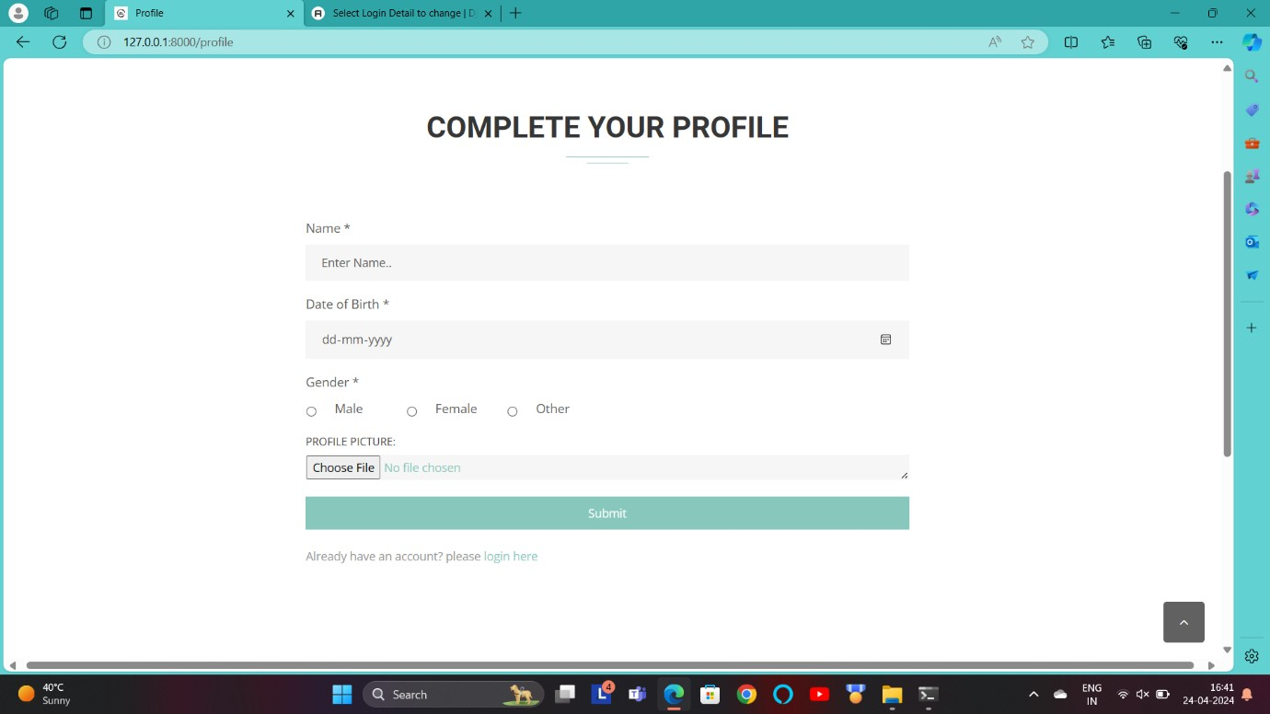
Description :- This screen-shot is after user is logged. User can access their dashboard from here.
Complete your Profile:-
Description:-This screen-shot is about user profile page. User can complete their profile by this page.

Slide 29
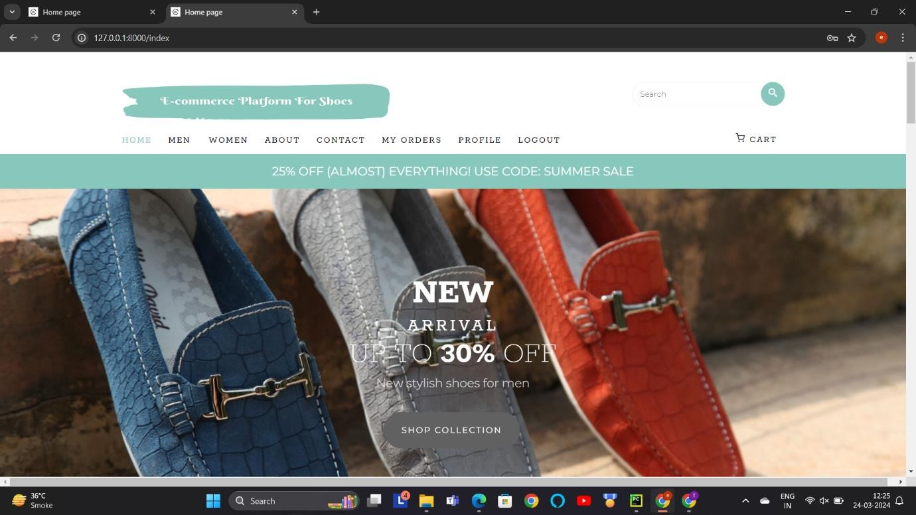
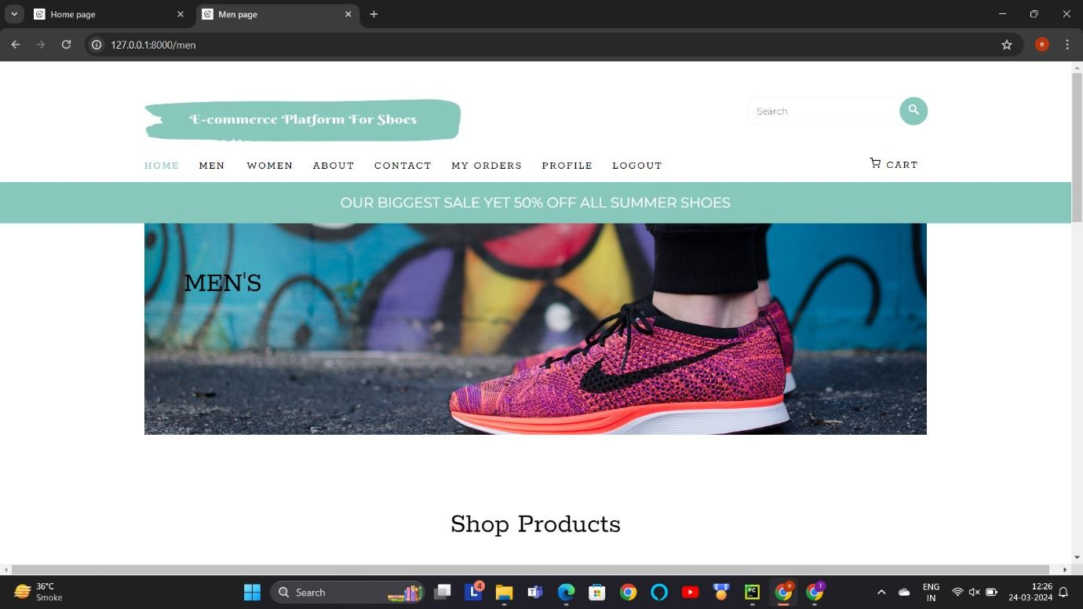
Choose Categories :-
Description :-This screen-shot is about all categories. User can choose a category according to their choices.
Mens:-

Slide 30
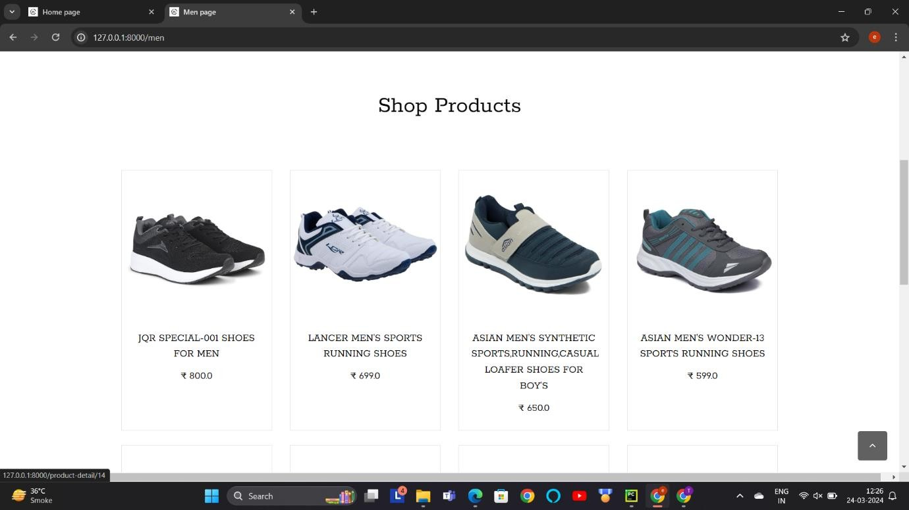
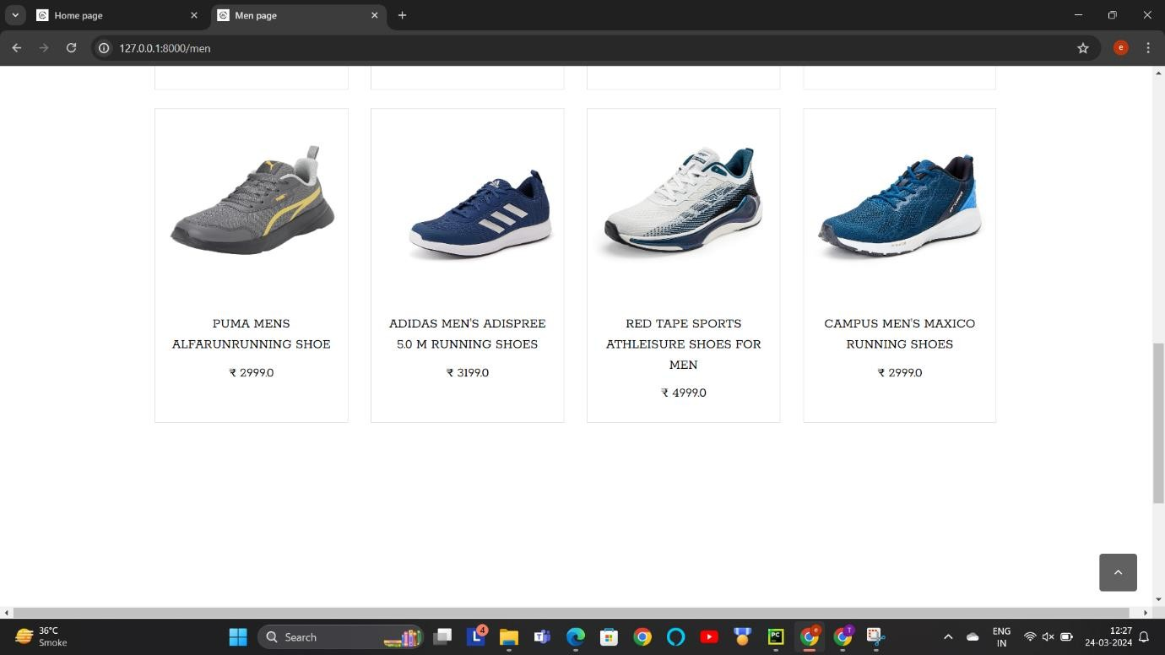
Description :- This screenshot displays products categorized under men's fashion. Users can browse through various products available in the men's category.

Slide 31
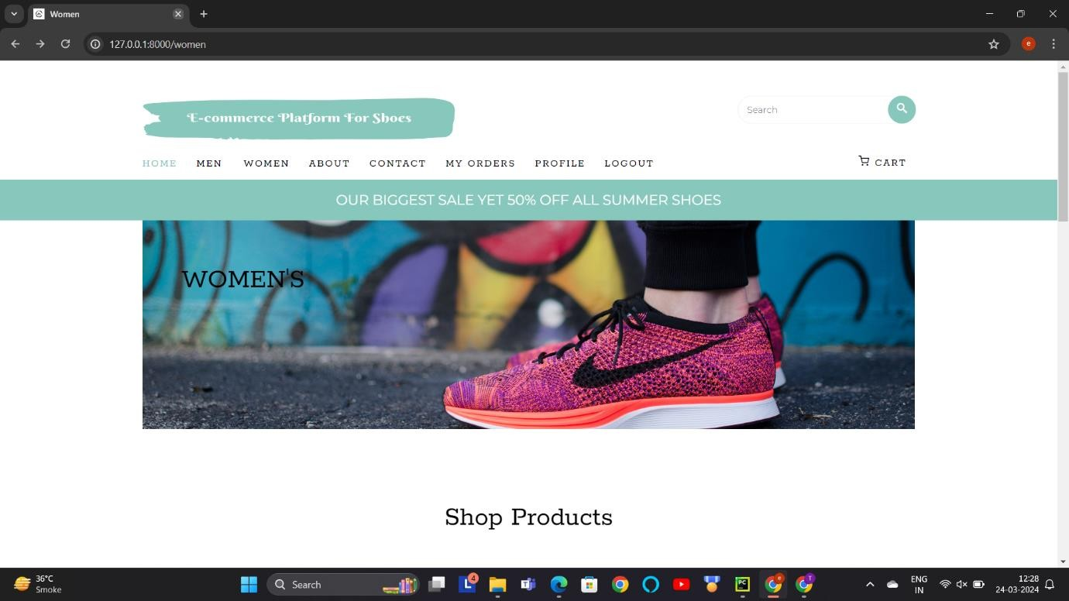
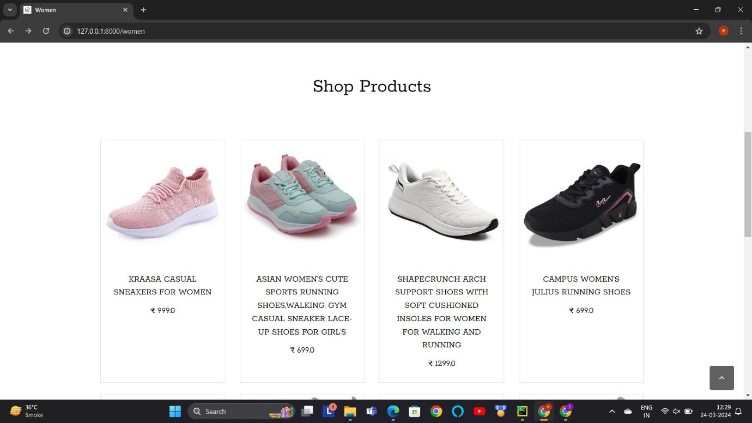
Womens:-
Description :- This screenshot displays products categorized under men's fashion. Users can browse through various products available in the men's category.

Slide 32
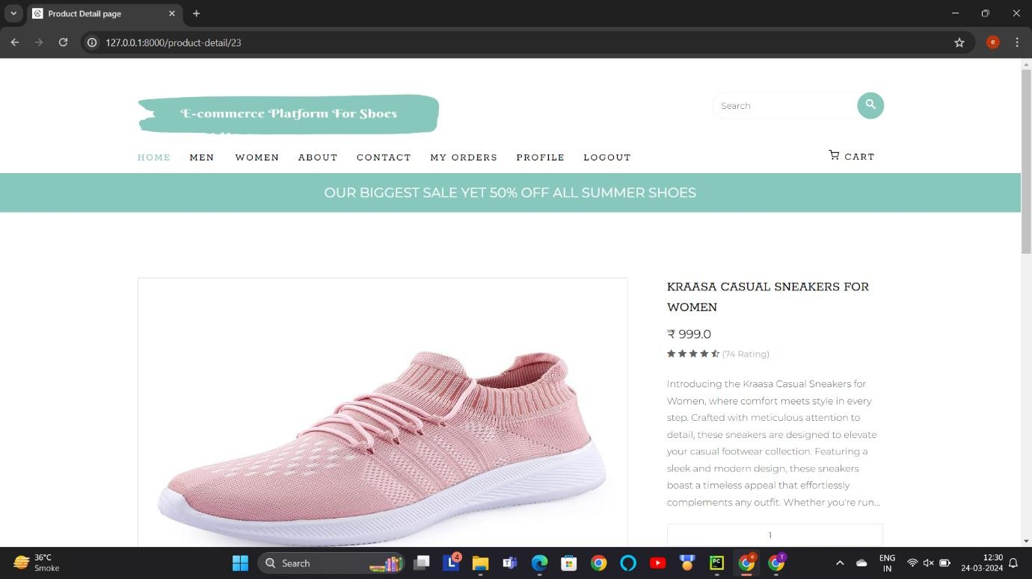
Buy Product:-
Description :- This screen-shot is about purchased product. Users can buy product according to their choices.
View Product Details :

Slide 33
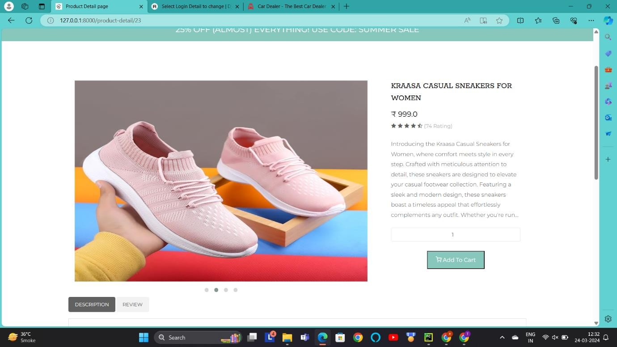
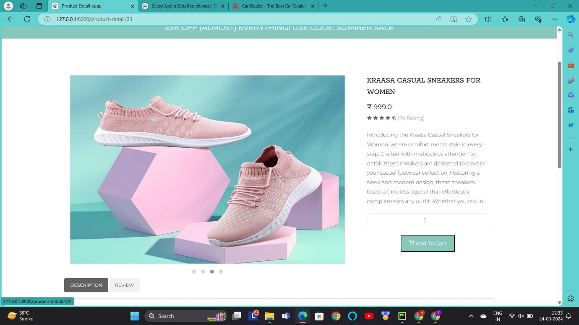

Slide 34
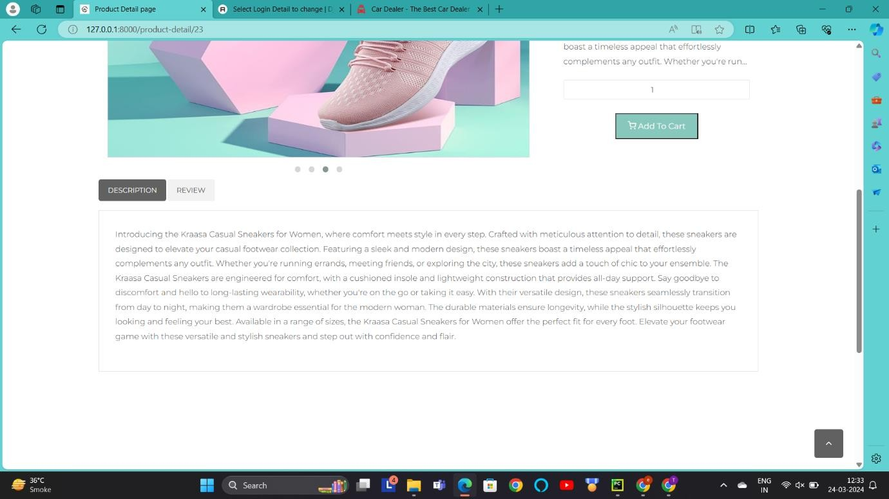
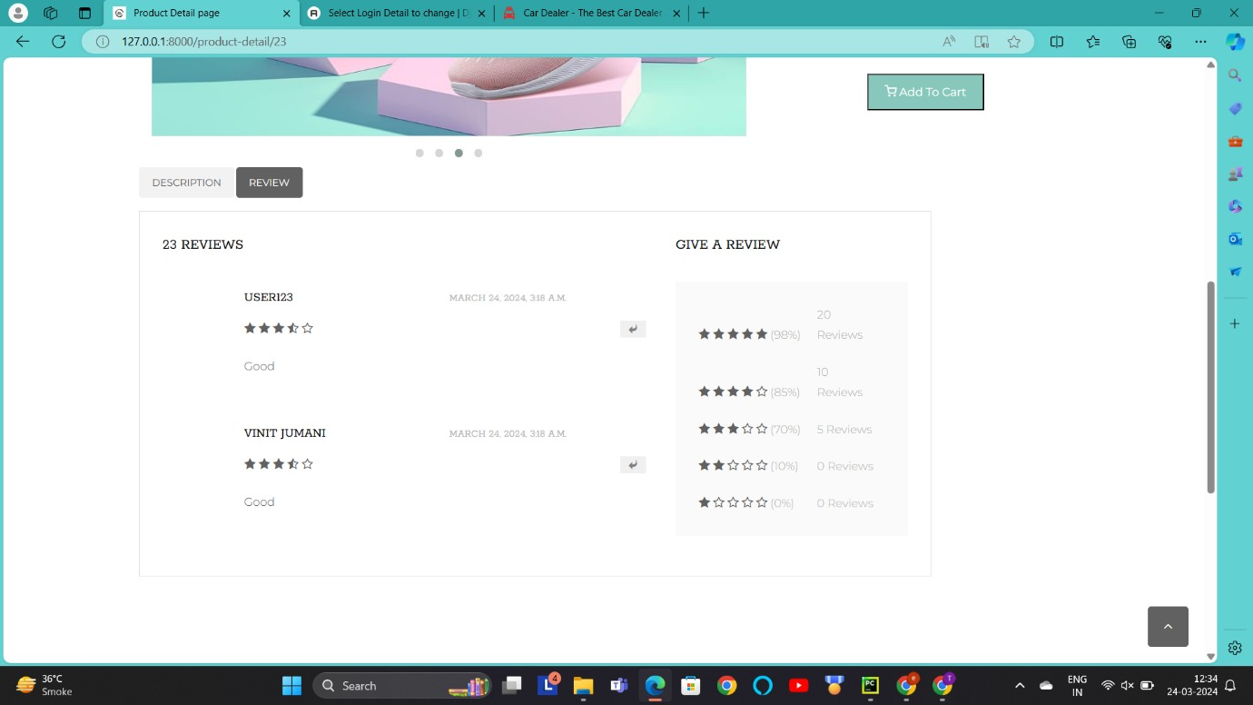
Description :-This screen-shot is about view product details. While user want to purchase any product they can see all the details from here.

Slide 35
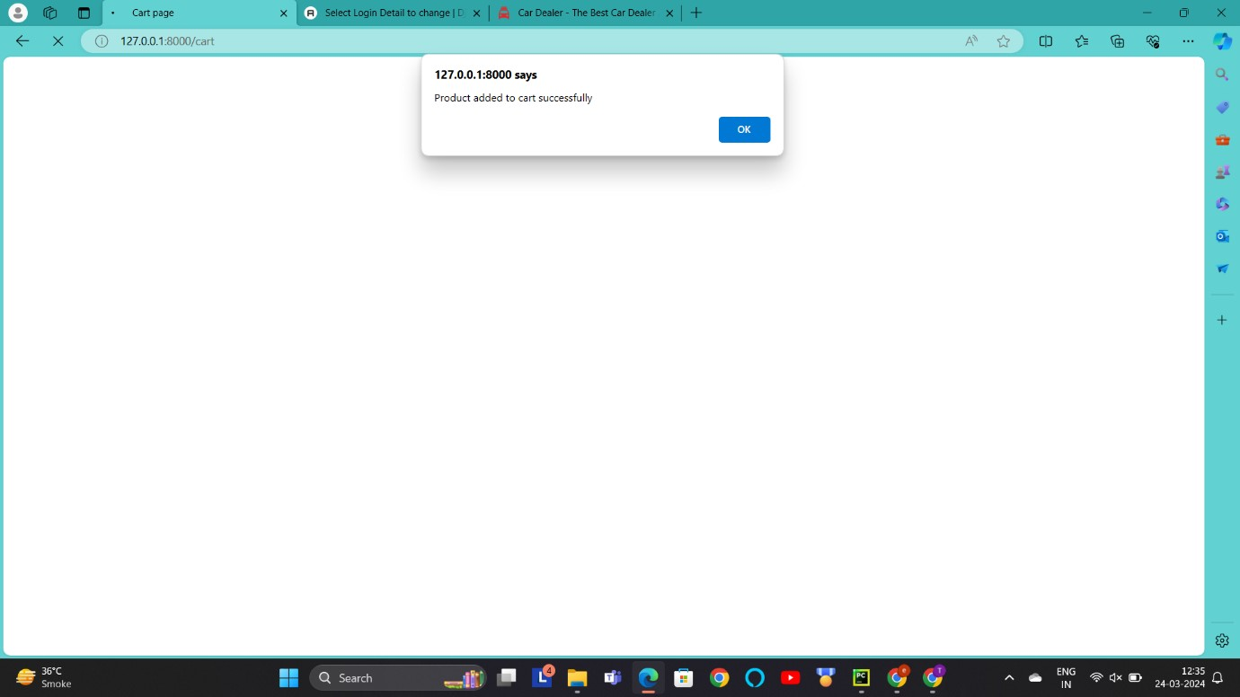
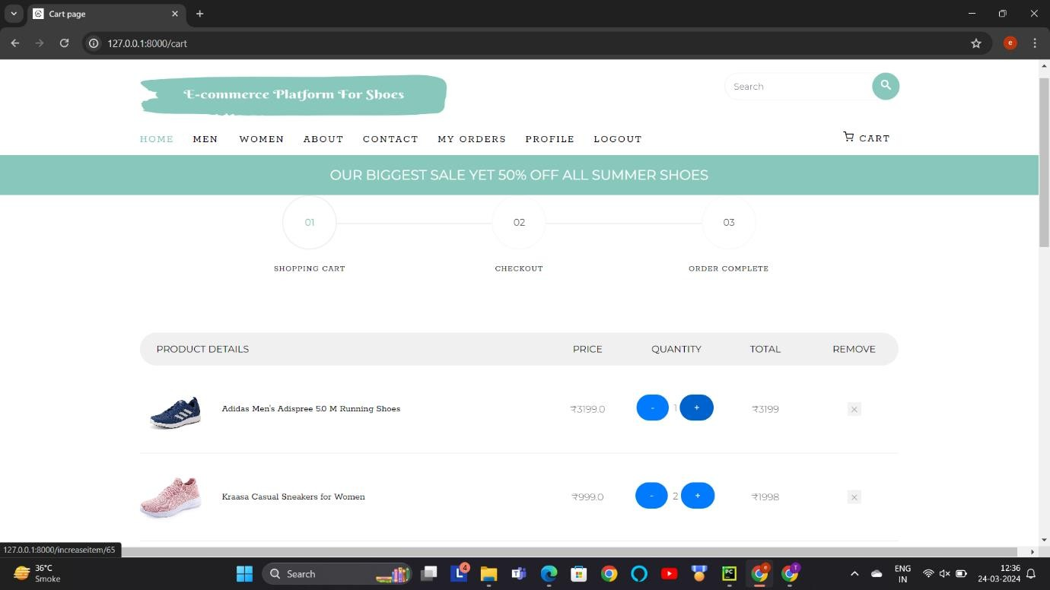
Add To Cart :-
Description :- This screen-shot is about add to cart. While user do add to cart this page will be shown at user side and user can check details.

Slide 36
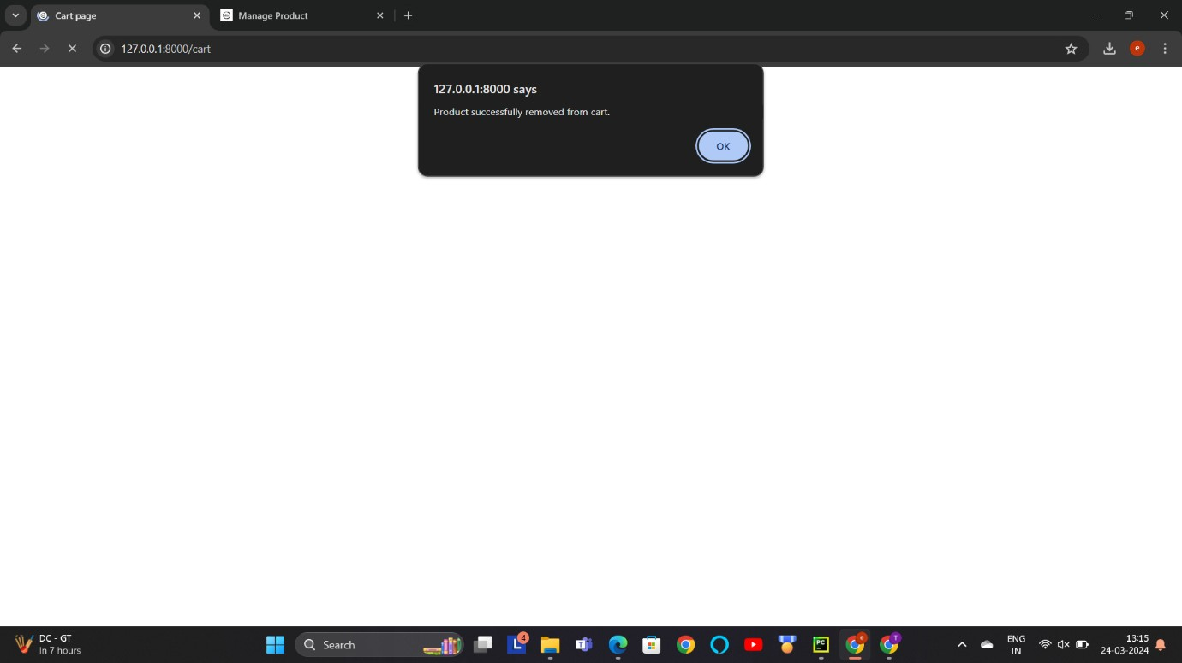
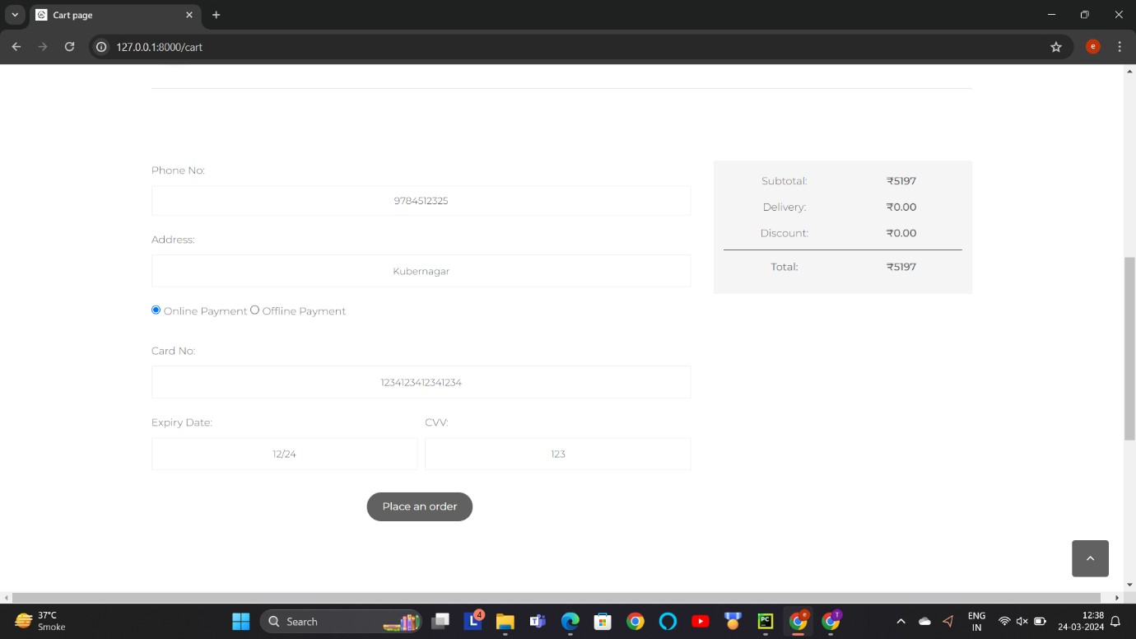
Remove Product From Cart :-
Add Details And Add Payment :-
Description :- This screen-shot is about add details. In this page user have to put details of name, address and also have to mention the method of payment.

Slide 37
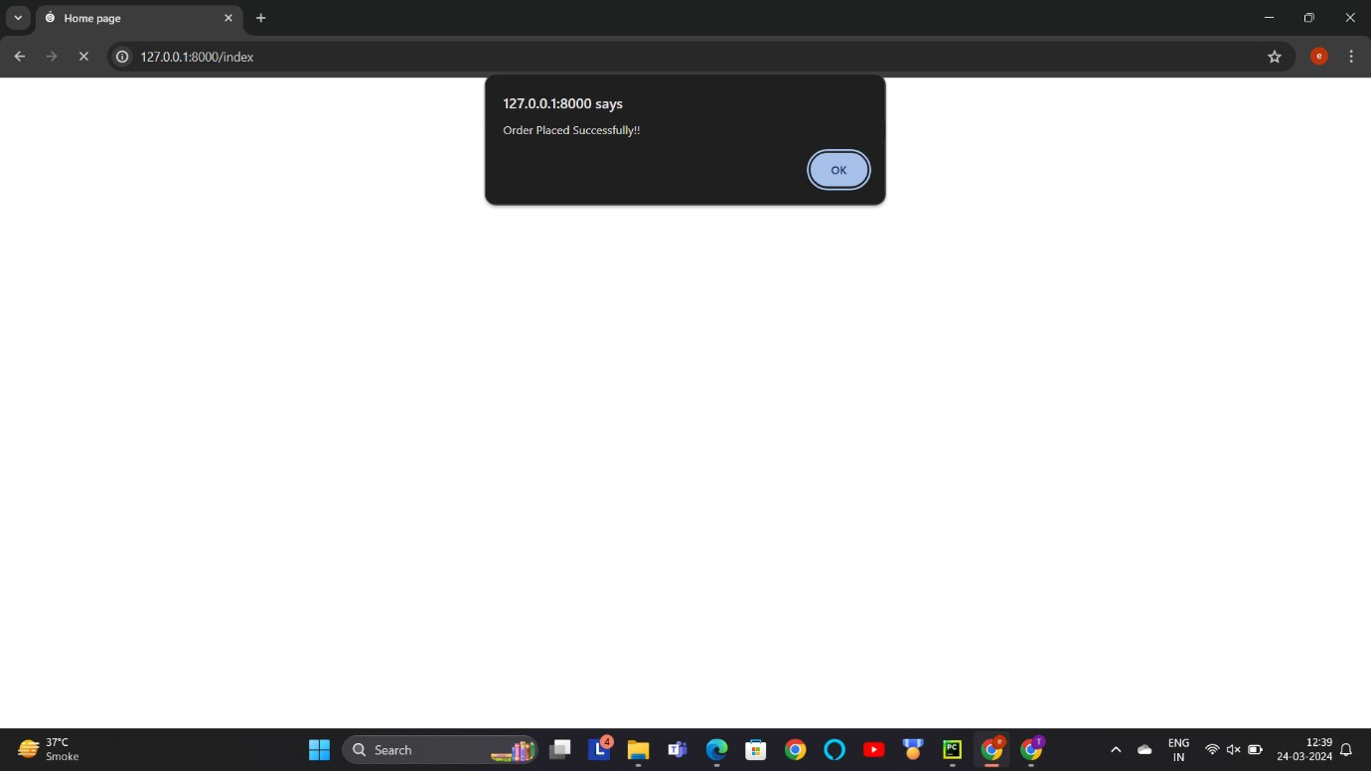
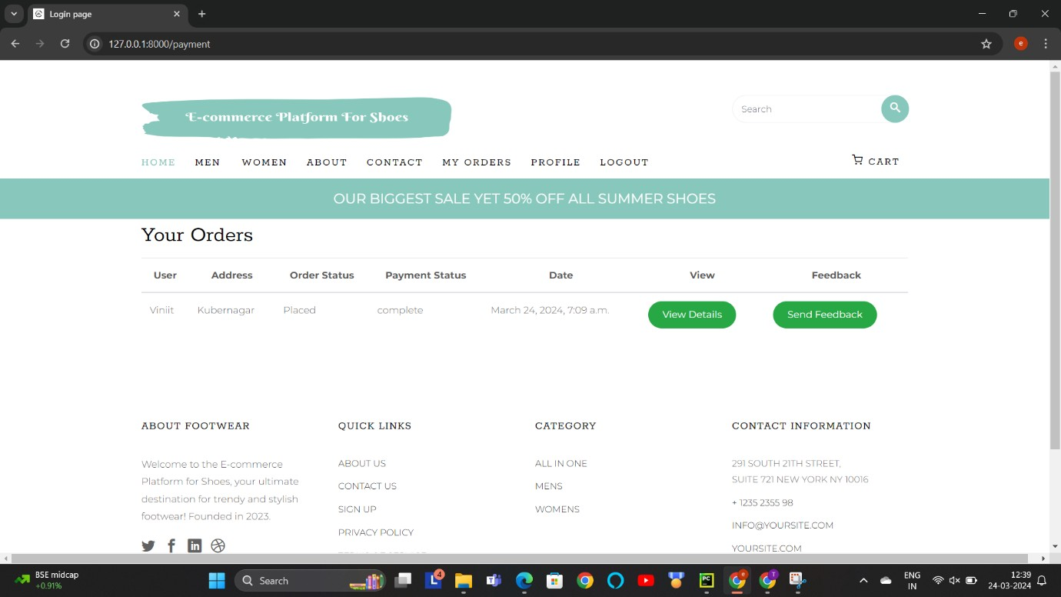
Order Placed :-
Description :- This screen-shot is about order placed. User can see a message order placed successfully.
My Order:
Description :- This screen-shot show the detail of all order of user

Slide 38
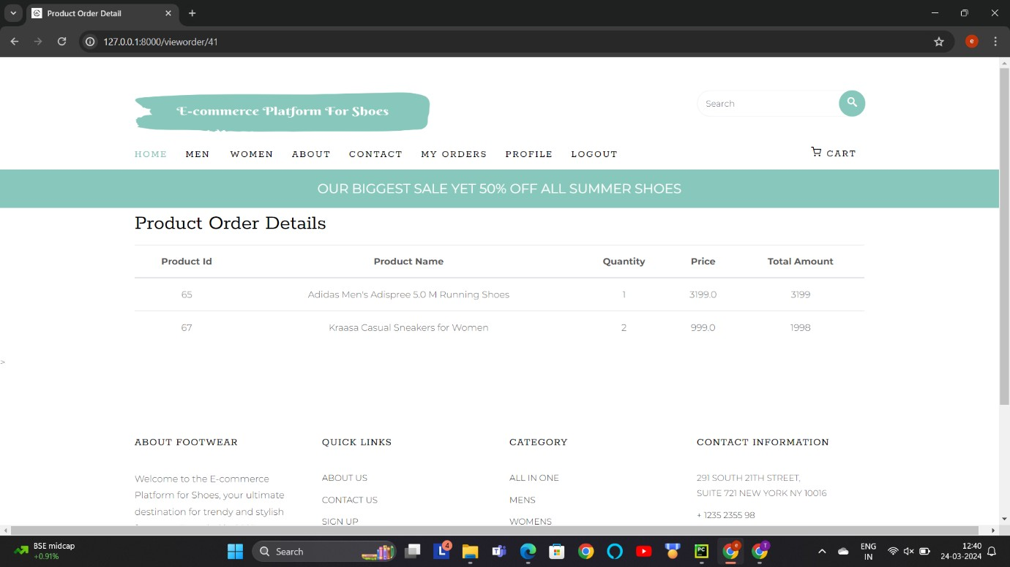
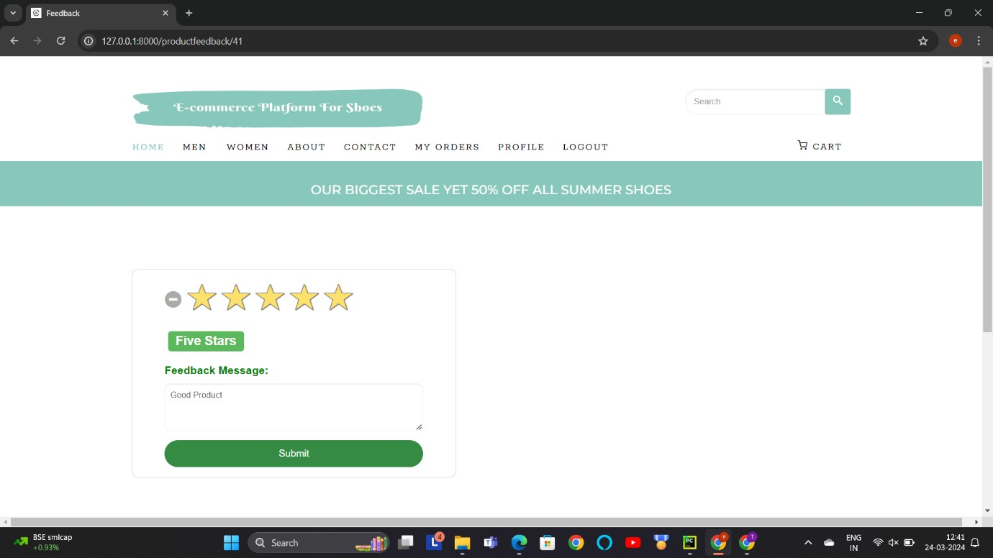
View Detail of order:
Description :- This screen-shot show the detail information of order.
Feedback:
Description :- This screen-shot is about feedback. User can give a feedback according to their choices.

Slide 39
VENDOR LAYOUT

Slide 40
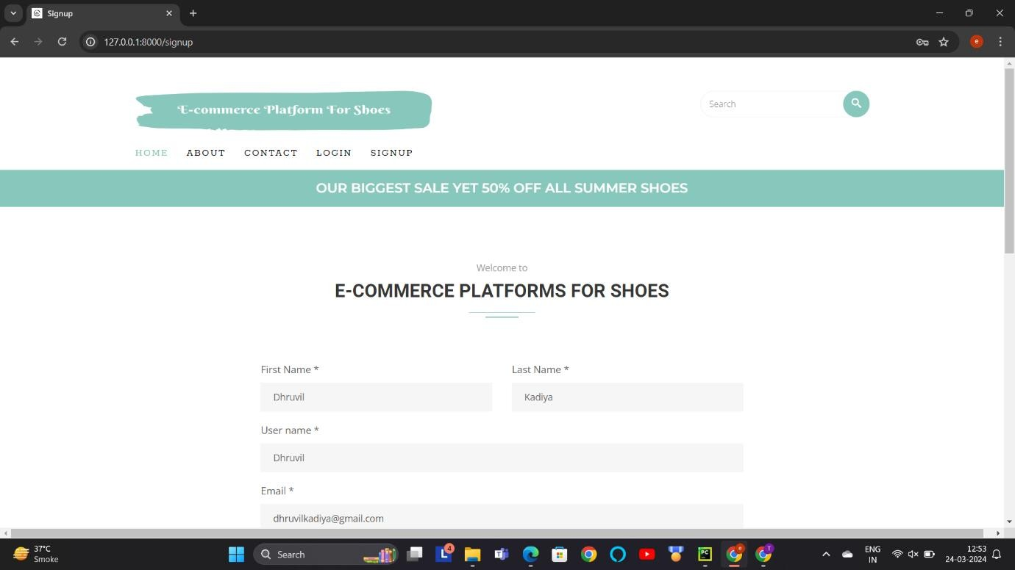

Registration Page:-
Description :- This screen-shot is about registration page.Vendor can register their self for purchasing any product.

Slide 41

Login Page :-
Description :- This screen-shot show when vendor is successfully registered. After registering vendor have to login.

Slide 42

Description :- This screen-shot is about login page. Vendor can login from here with their email id and password.

Slide 43

Complete your Profile:-
Description :- This screen-shot is after user is logged. User can access their dashboard from here.
Description:-This screen-shot is about user profile page. User can complete their profile by this page.

Slide 44


Add Product :-

Slide 45



Slide 46


Manage Product :-
Description :- This screen-shot is about add product page.Vendor can add the new product from here.
Description :- This screen-shot is about manage product page. Vendor can add the edit product from here and manage all the products.

Slide 47


Edit/Update Product Data:-

Slide 48

Description :- This screen-shot is about Edit product page. Vendor can edit product from here.
Description :- This screen-shot is about manage product page. Vendor can delete product from here.

Slide 49

Description :- This screen-shot is about delete product page.

Slide 50
REPORT LAYOUT

Slide 51


Product Detail Report Before Generating:-
After generating as pdf form:-

Slide 52


Product Order Report Before Generating:-
After generating as pdf form:-

Slide 53


Payment Detail Report Before Generating:-
After generating as pdf form:-

Slide 54


Login Report Before Generating:-
After generating as pdf form:-

Slide 55


Sample Coding
Views.py:-

Slide 56


Models.py:-

Slide 57


urls.py:-

Slide 58
Future Enhancements
Social Integration: Integrate social media features to allow users to share their favorite shoe finds, reviews,
and purchases with friends and followers. This enhances engagement and word-of-mouth marketing for the
platform.
Customization Options: Offer customization features that allow users to personalize their shoes with different colors, materials, or designs. This adds a unique selling point and increases customer satisfaction by providing
tailored products.
Real-Time Inventory Management: Implement real- time inventory management to ensure accurate stock
availability information. This prevents disappointment due to out-of-stock items and improves overall customer experience.
Virtual Styling Consultations: Provide virtual styling consultations with professional stylists to help users
choose the perfect shoes for their outfits or occasions. This adds value to the shopping experience and builds
customer loyalty.
Gamification Elements: Incorporate gamification elements such as loyalty programs, challenges, or
rewards for completing certain actions on the platform. This encourages user engagement, repeat visits, and brand loyalty.

Slide 59
BIBLIOGRAPHY
https://www.google.com/
https://youtube.com/
https://www.w3schools.com/
https://www.javatpoint.com/

Slide 60
CONCLUSION
It was wonderful and learning experience for me while working on this project.
This project took me through various aspects of project and taught me about research and findings. It also give me real insight into this project. This project was full of thrill and joy.
We learned a lot about problem-solving and how to deal with challenges.

